Slide 1
Operational Taxonomic Units (OTUs)
Bridget O’Brien
Theory of Microbiome Analysis Workshop
October 3, 2022

Slide 2
Next Generation Sequencing
A small fraction of microbial communities are culturable
Cultivation-independent methods, like next generation sequencing (NGS), are essential to identify and characterize microorganisms in various environments
NGS:
  2nd generation: Massively parallel sequencing (short reads)
  3rd generation: Single-molecule sequencing (long reads)
16S rRNA gene amplicon sequencing

Slide 3
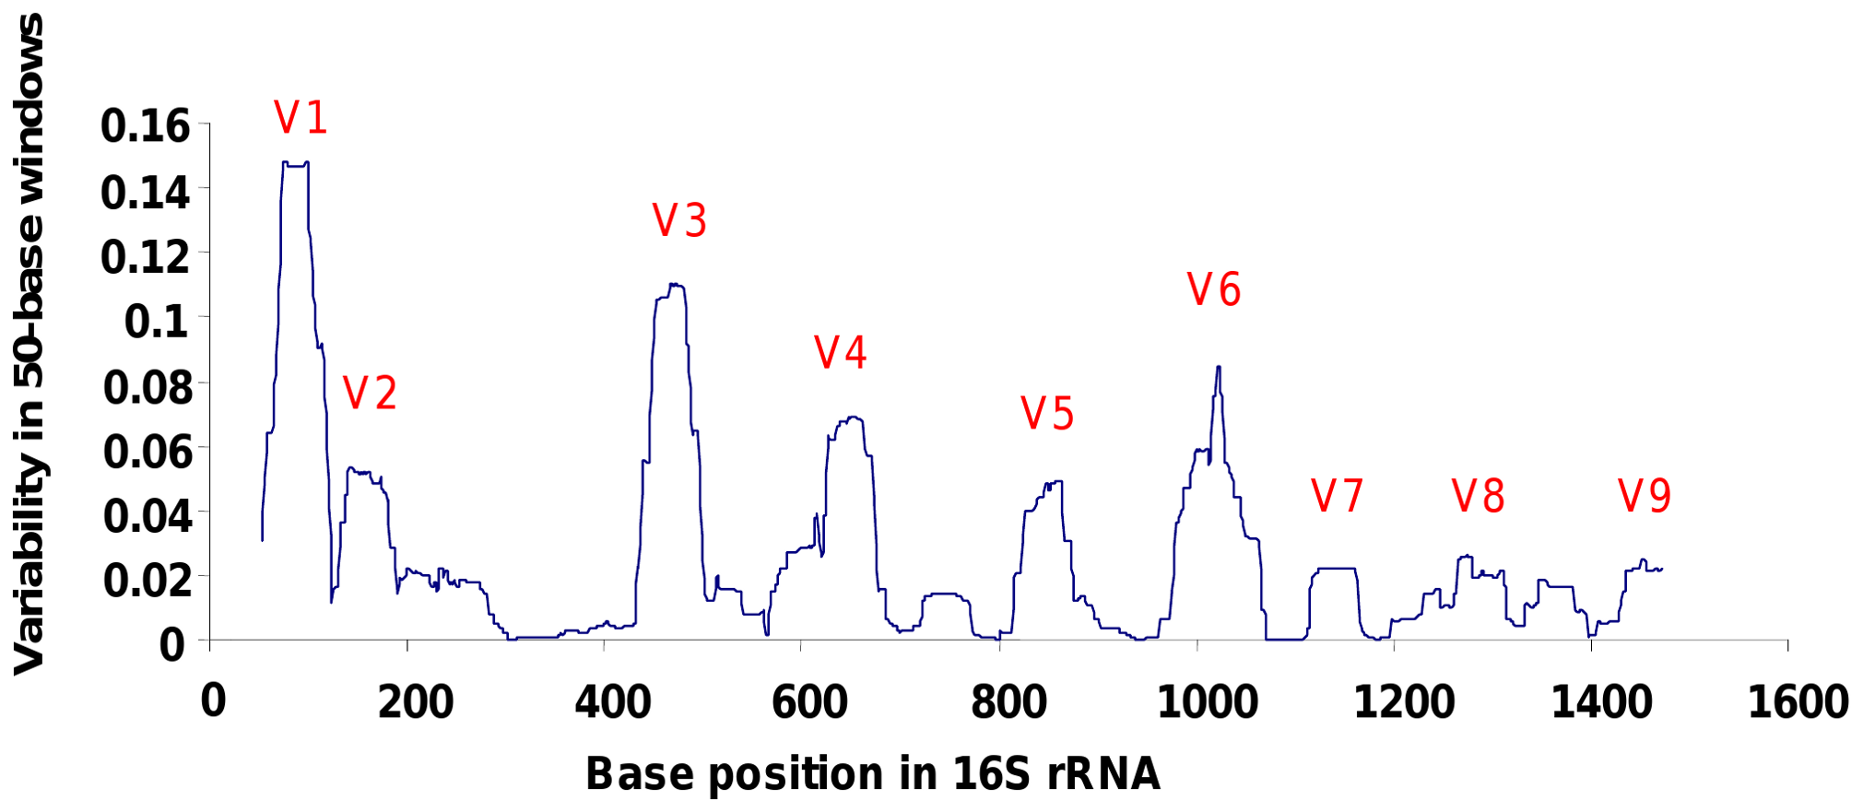
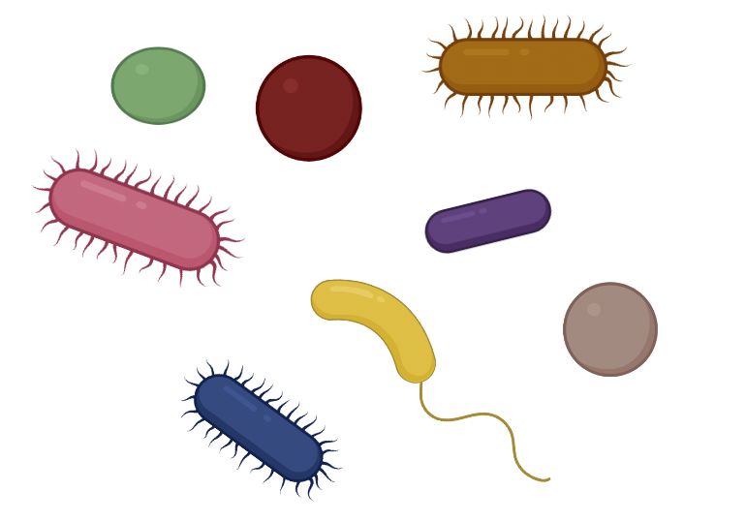
16S rRNA Gene Amplicon Sequencing
Sequences a variable region of the 16S rRNA gene
  Can allow for taxonomic identification in mixed microbial samples
Notes:
NGS enabled low cost, high throughput sequencing of the 16s gene. These came at expense of shorter read lengths and higher error rates compared to sanger

Slide 4
16S rRNA Gene Amplicon Sequencing
Sequencing generates random amplicon reads from samples
There will be some errors – don’t want to mistake these for real diversity/new species
Artifacts = sequences NOT generated by our samples
Artifacts obscure from what the true microbial community composition is
Typically, artifacts are removed during quality control, however they may persist
To minimize the risks of artifacts on analysis and to identify taxonomy, clustering approaches were initially developed

Slide 5
Taxonomic Identification Through Clustering
Can cluster sequences into operational taxonomic units (OTUs) based upon similarity (typically 97% similarity)
Use one representative sequence for downstream analysis → more tractable
Based on assumption that related/similar organisms will have similar target gene sequences and artifacts will have a minor contribution to the consensus OTU sequence
Two OTU clustering approaches:
  Reference dependent
  Reference independent
Notes:
OTU is really just referring to the group of organisms being studied

Slide 6
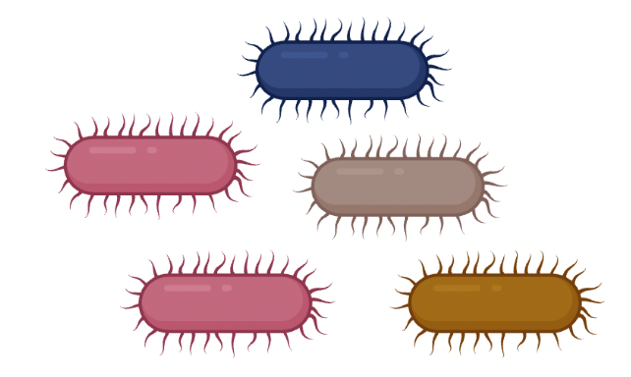
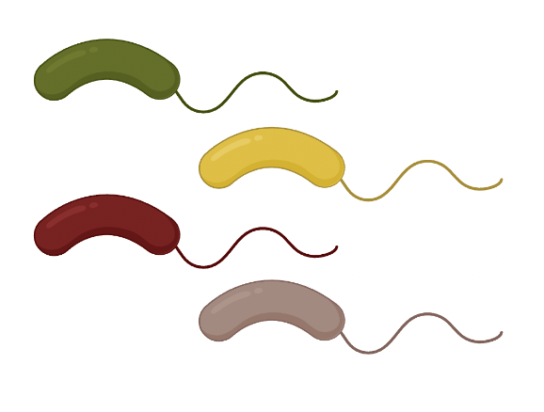
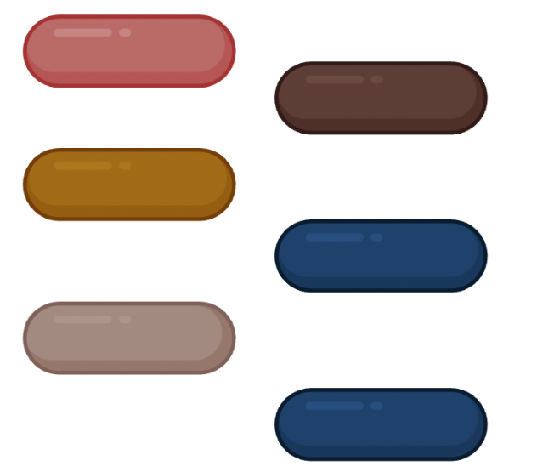


Reference Independent
de novo
  Calculates the distance between all pairs of samples
  Groups sequences with distance threshold (usually of 3%)
  Computationally expensive
  Must re-cluster when new sequences are added in

Slide 7

Reference Independent
de novo
  Calculates the distance between all pairs of samples
  Groups sequences with distance threshold (usually of 3%)
  Computationally expensive
  Must re-cluster when new sequences are added in

Slide 8
Reference Independent
de novo
  Calculates the distance between all pairs of samples
  Groups sequences with distance threshold (usually of 3%)
  Computationally expensive
  Must re-cluster when new sequences are added in

Slide 9
Reference Independent
de novo
  Calculates the distance between all pairs of samples
  Groups sequences with distance threshold (usually of 3%)
  Computationally expensive
  Must re-cluster when new sequences are added in

Slide 10



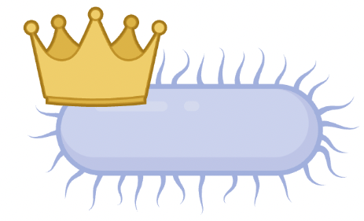
Reference Dependent
Open reference
  Clusters similar sequences to sequences found in a database (e.g. Greengenes, Ribosomal Database Project, or SILVA)
  Performs de novo clustering on sequences which don’t match database

Slide 11
Reference Dependent
Closed reference
  All sequences be clustered around reference database
  Removes sequences that don’t match database
  Good for samples extensively studied, but bad for understudied microbial communities

Slide 12

Reference Dependent
Closed reference
  All sequences be clustered around reference database
  Removes sequences that don’t match database
  Good for samples extensively studied, but bad for understudied microbial communities

Slide 13
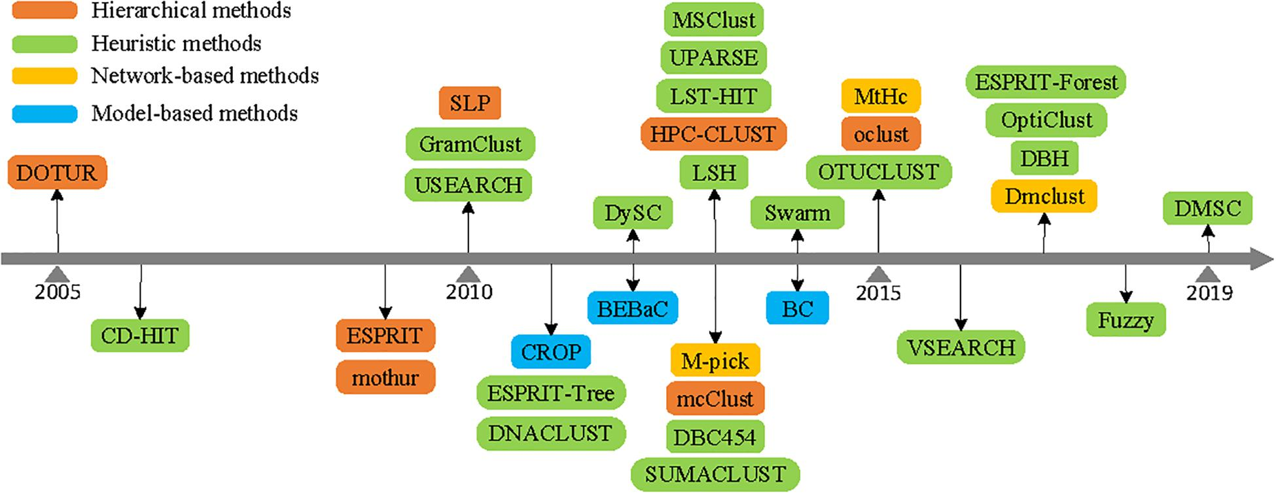
Most Researchers Use de novo OTU Clustering
Source: Wei et al., 2021

Slide 14
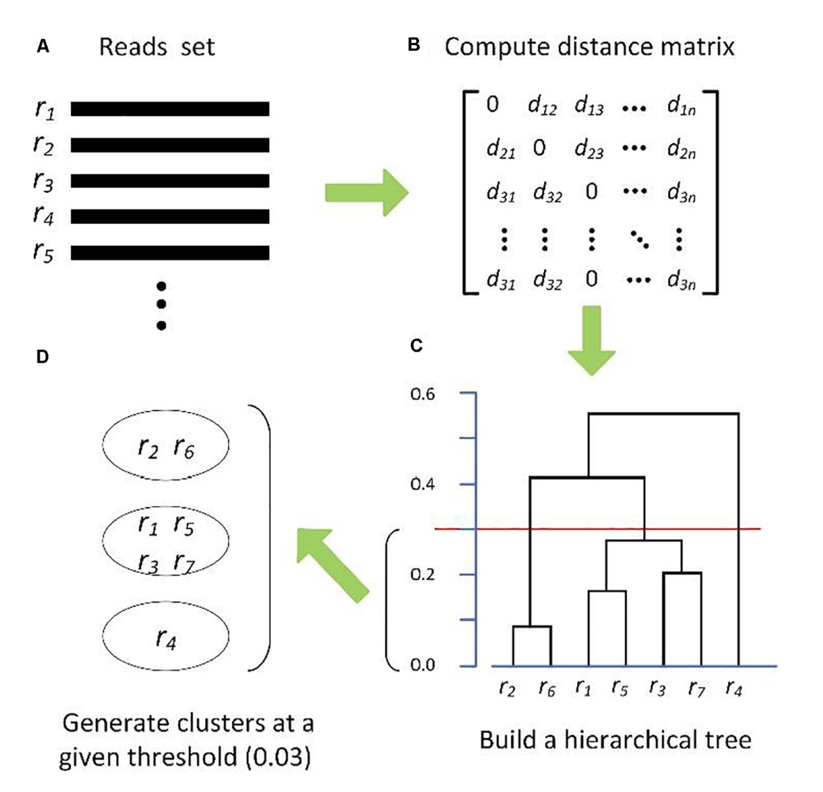
Hierarchical clustering
Requires a distance matrix between all sequence alignments derived either from pairwise sequence alignment or a multiple sequence alignment
Builds a hierarchical tree with a predefined threshold to assign sequences into OTUs
e.g. mothur, HPC-CLUST, ESPIRIT, mcClust
Source: Wei et al., 2021

Slide 15
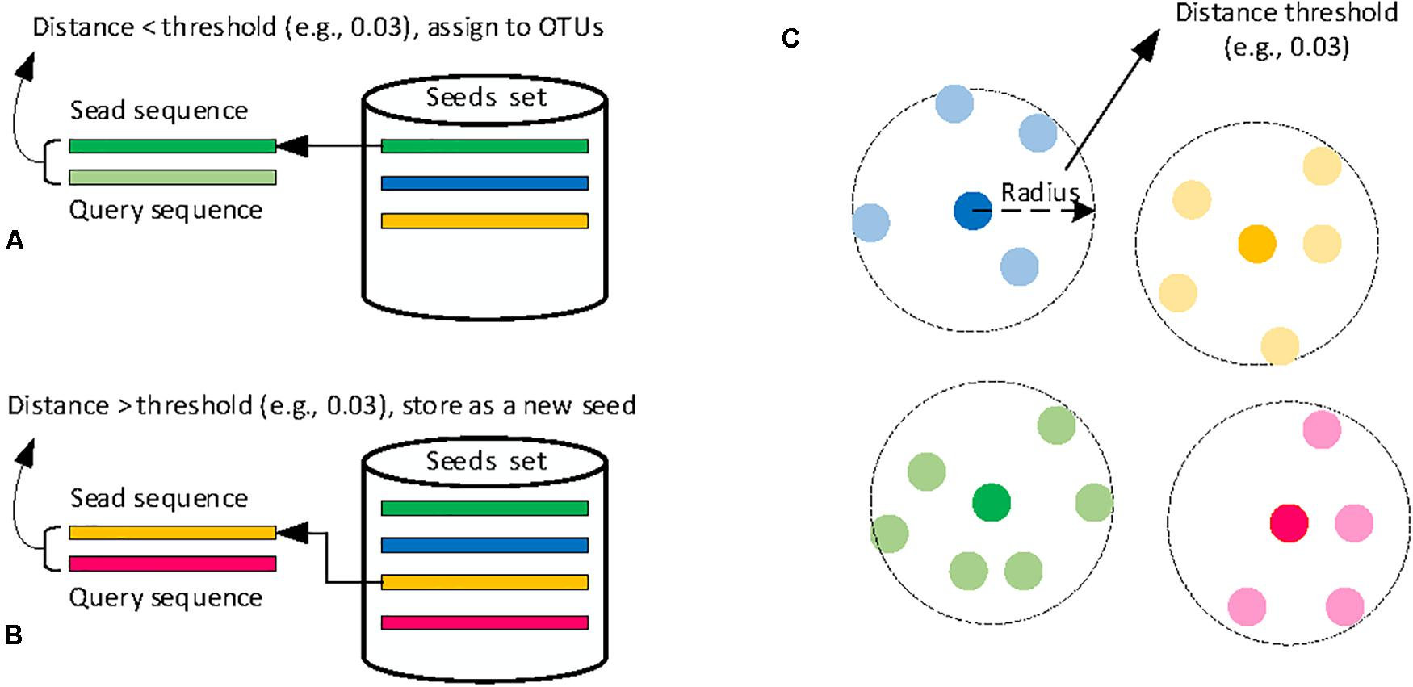
Heuristic clustering
Input sequences one by one
A cluster is represented by one sequence (called a seed)
Each query sequence is compared to all the seeds of existing clusters
If it is < 0.03 distant → stays in that cluster
If it is > 0.03 distant → becomes new seed of a new cluster
Source: Wei et al., 2021
Computationally more efficient than hierarchical and therefore are more widely used
e.g. CD-HIT and USEARCH
Notes:
More efficient because you input sequences one by one as opposed to calculating distance of all sequences

Slide 16
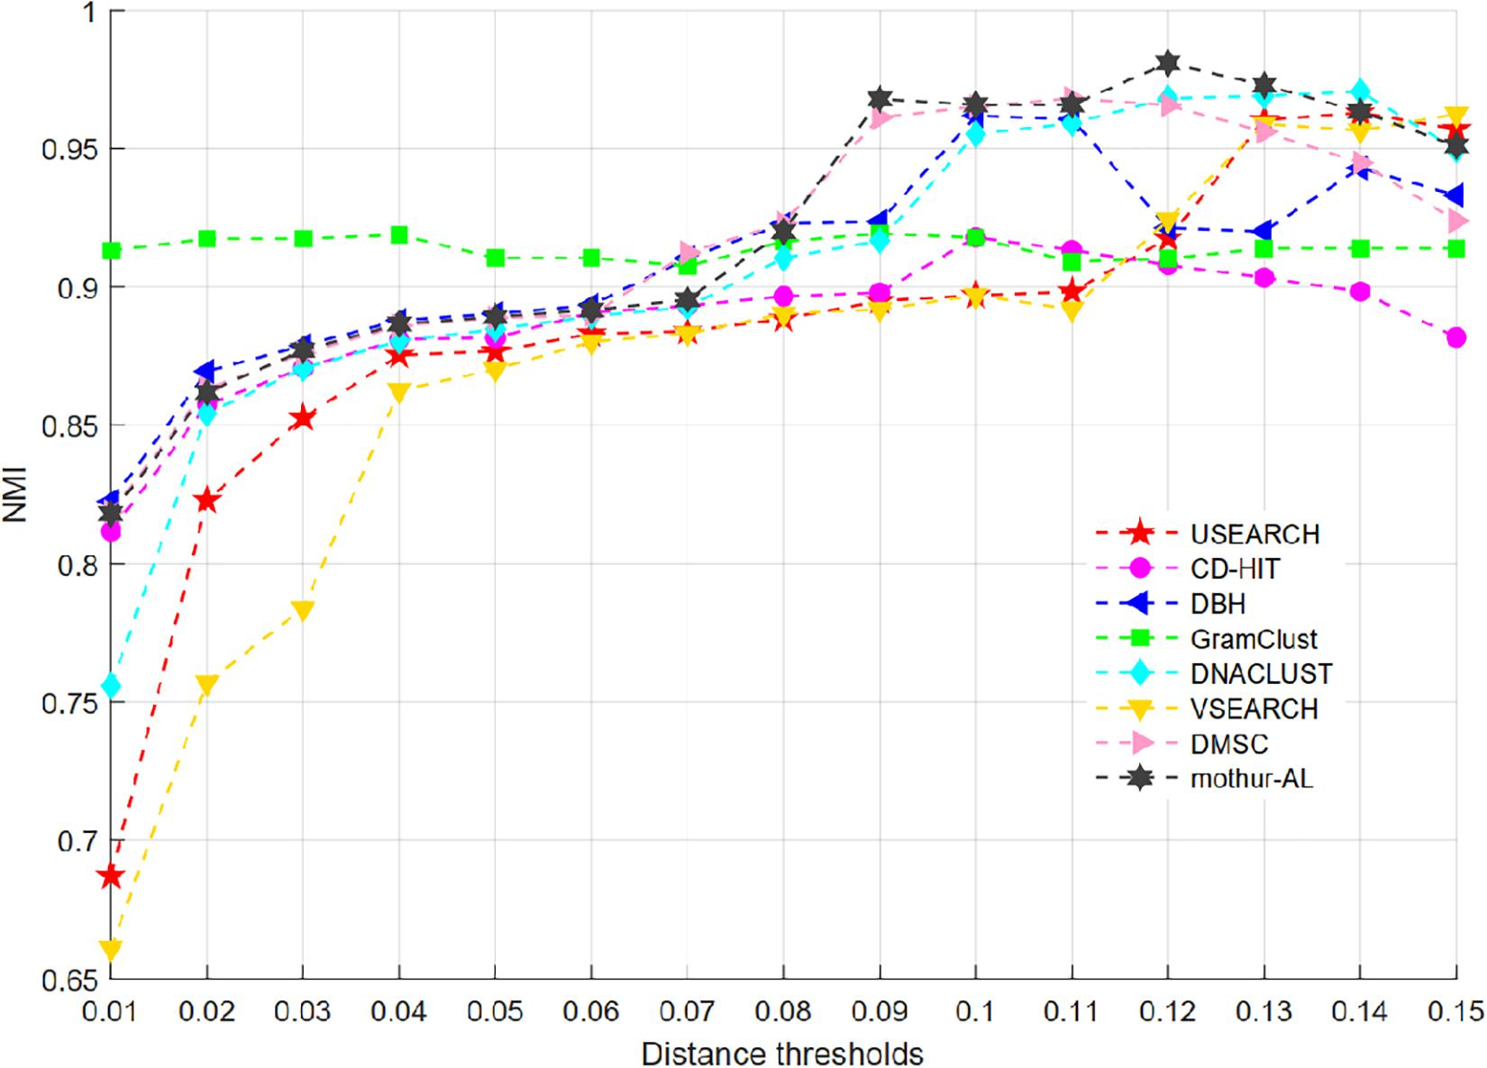
Comparison of OTU Clustering Methods
NMI = Normalized Mutual Information
Applied to estimate the clustering accuracy (i.e. how the outcome of one clustering algorithm agrees with the ground truth)
Source: Wei et al., 2021

Slide 17
OTU Clustering is Not Perfect
May result in artifacts being grouped together
Clustering artifacts may make samples appear more diverse than they actually are
May result in 16S rRNA sequences from different species being grouped together
OK if goal of the study is having 1 OTU/phenotype
Many researchers have argued that the 3% distance threshold to define OTUs is too coarse
Researchers have suggested using amplicon sequence variants (ASVs) which reflect a finer taxonomic level and removes low abundant sequence based on error model results

