Slide 1
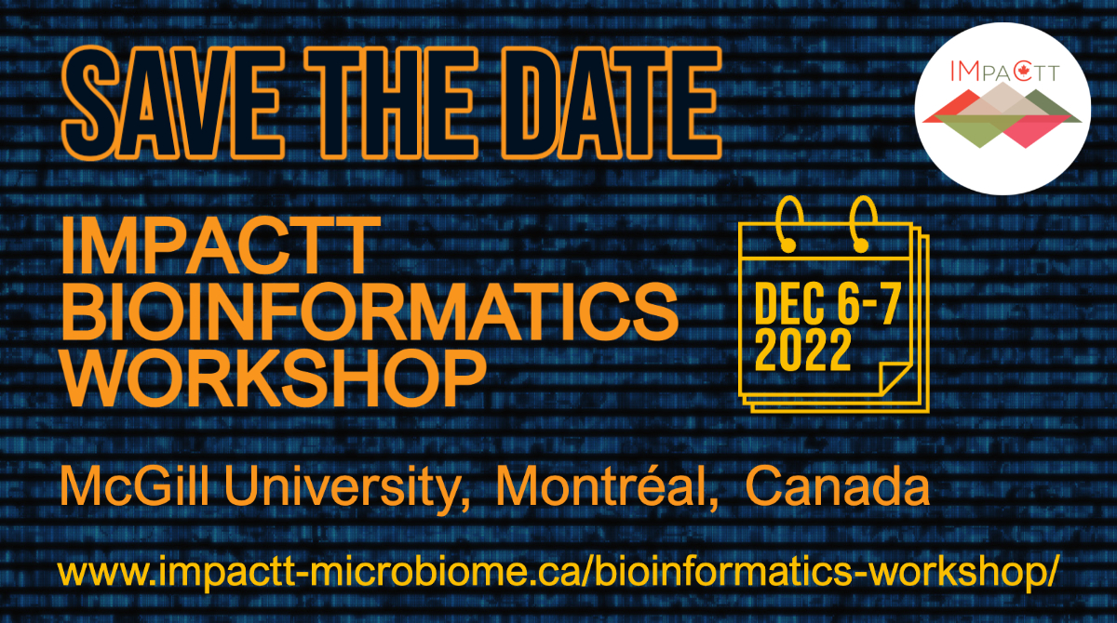

Slide 2


Theory of Microbiome Analysis
Food Safety and Quality Program

Slide 3
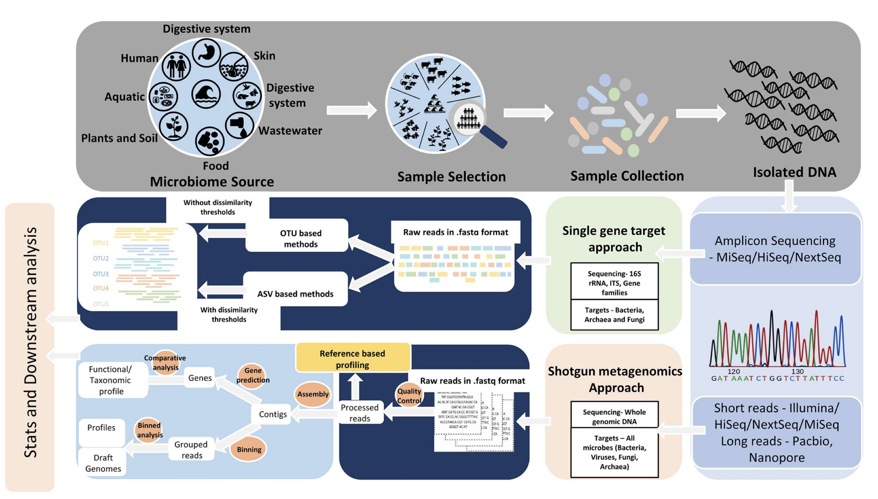
Microbiome Analysis
Bharti & Grimm 2021

Slide 4
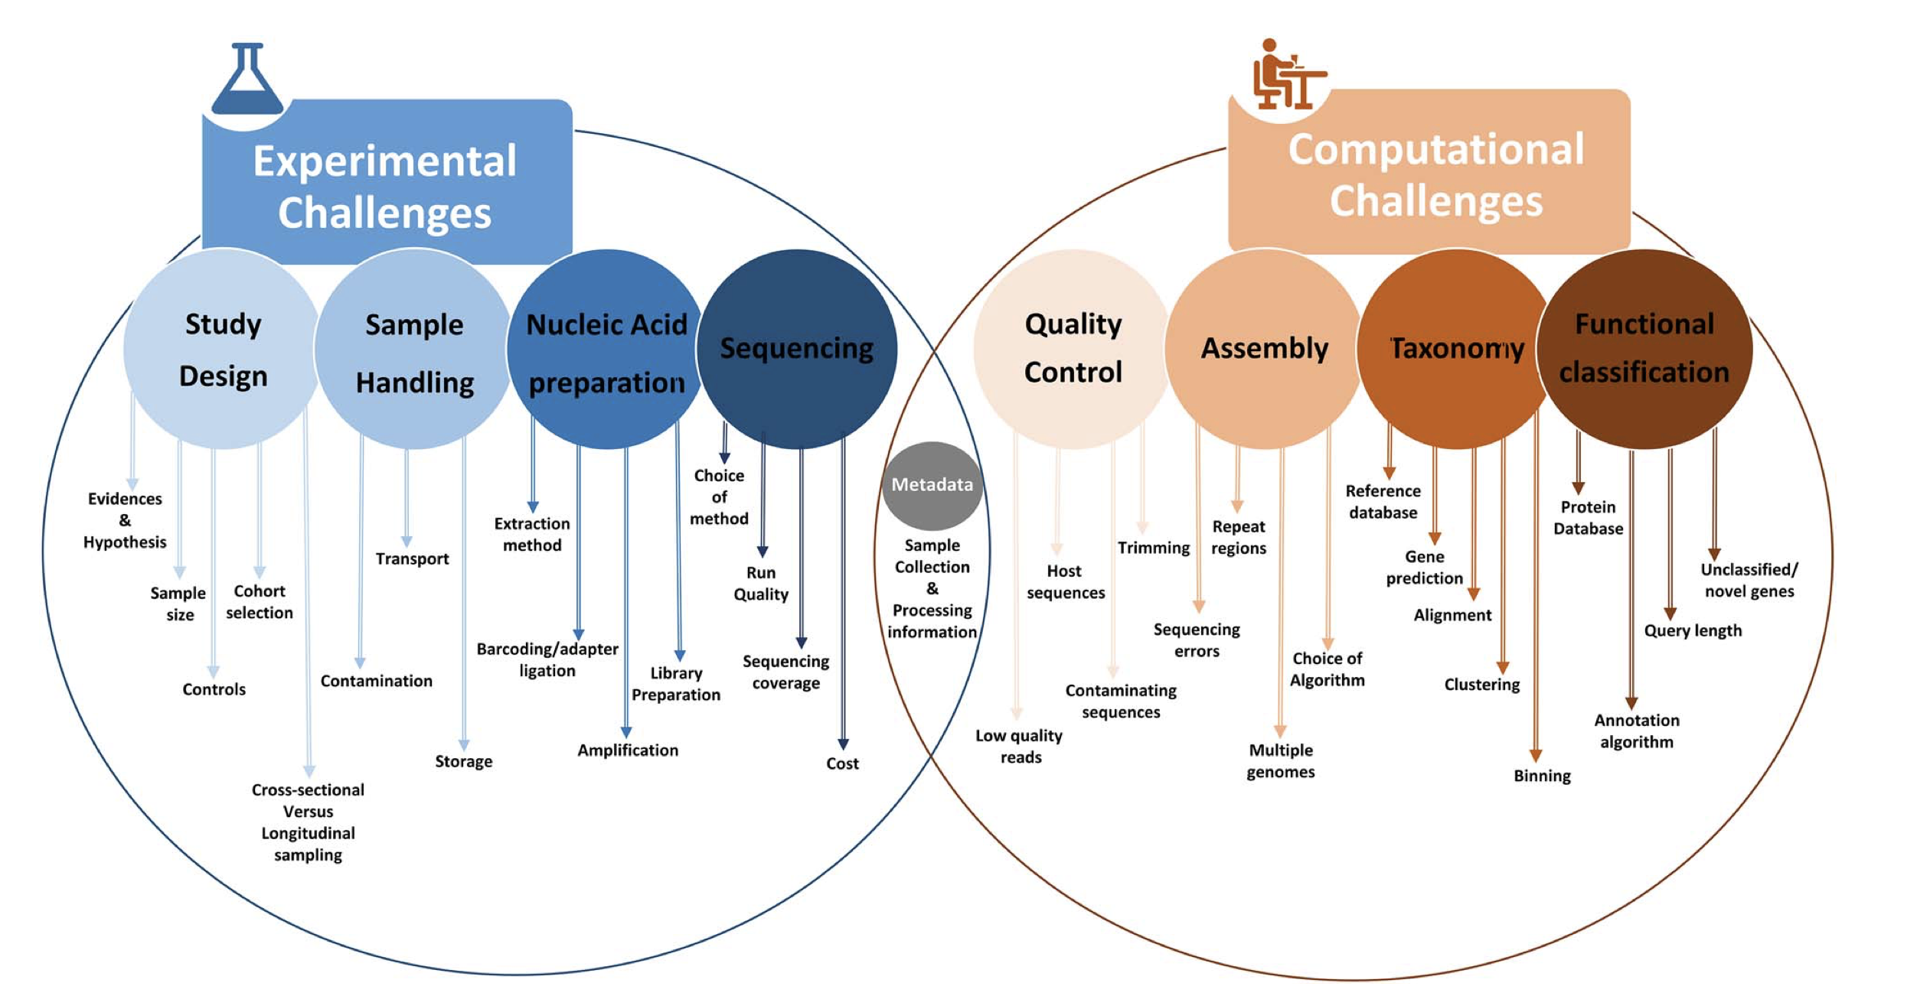
Microbiome Analysis
Bharti & Grimm 2021

Slide 5
Current Practices
There is not a standardized way to conduct 16S rRNA targeted amplicon sequencing and data analysis
  Unique primers are used
  There are different lengths of sequencing
  Different processing pipelines
  Different measures of alpha and beta diversity
Bardenhorst et al., conducted a systematic review of current practices based on 419 papers published on human gastrointestinal microbiome analysis

Slide 6
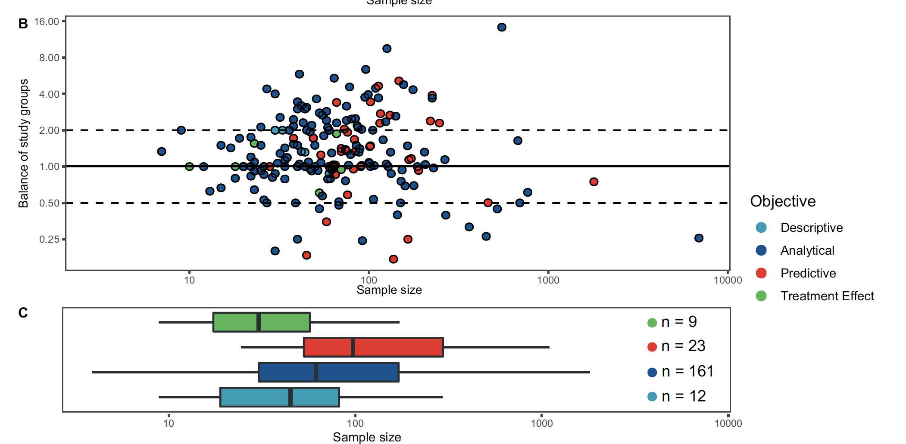
Current Practices
How many samples do people collect?
Minimum 5 per group (10 in total).
Maximum 6896 from two groups 1404 in group 1 and 5492 in group 2
Bardenhorst et al., 2021

Slide 7
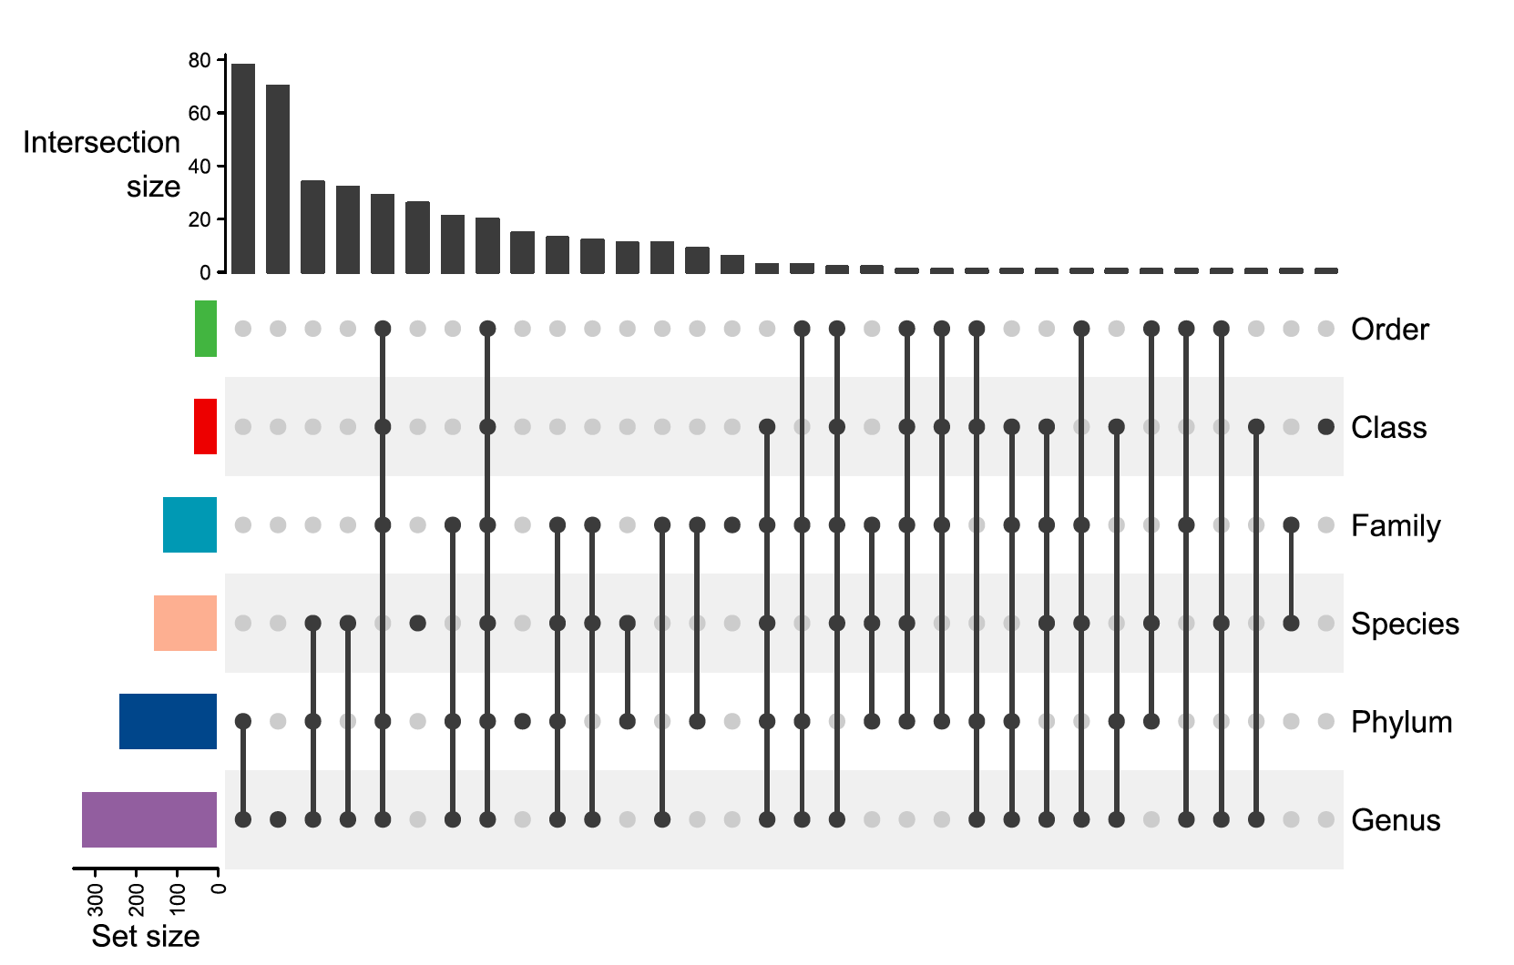
Current Practices
What taxonomic levels are investigated?
The majority of studies (96.9%) use OTUs and 3.1% use ASVs
Genus is the most frequently used taxonomy leve. (75.7%)
Bardenhorst et al., 2021

Slide 8
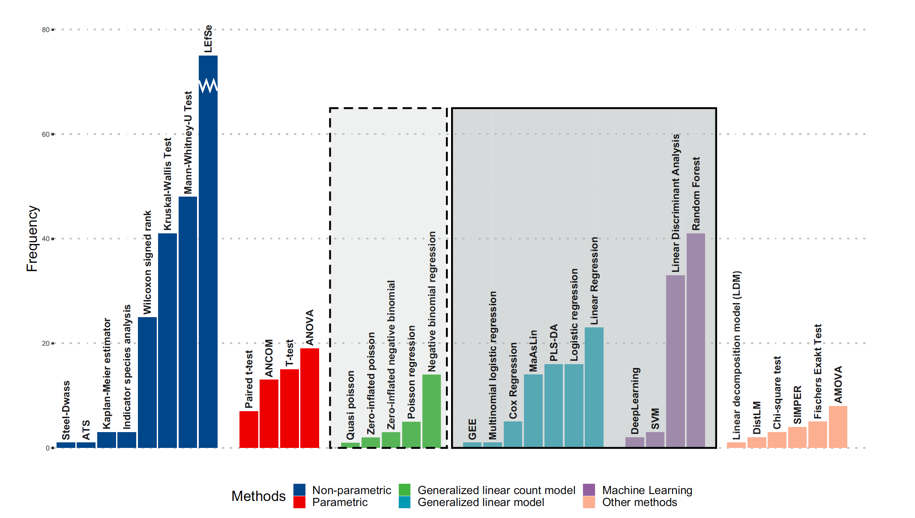
Current Practices
What methods are used for differential abundance testing?
Among the papers examined, 77% included some type of differential abundance testing, and 45 different approaches were used.
Only about 58.1% corrected for multiple testing (this should be done to address multiple testing).
LEfSe was the most common test used (58.9%)
Bardenhorst et al., 2021

Slide 9
Microbiome Analysis
Raw Reads in .fastq format
Mothur
OTUs
LEfSe
Wilcoxon
DESeq2
edgeR
QiiME2
Normalization
DADA2
ASVs

Slide 10
Format of the Workshop
9:30-10:15 Sequence Clustering – What do you use and Why?
9:30-9:45 OTUs (Bridget O’Brien)
9:45-10:00 ASVs (Esteban Góngora)
10:00-10:15 Questions and Discussions
10:15-Marker Gene Analysis - What do you use and Why?
10:15-10:30 Mothur (Zhiwei Li)
10:30-10:45 QiiME2 (Zhiwei Li)
10:45-11:00 DADA2 (Esteban Góngora)
11:00-11:15 Questions and Discussions

Slide 11
Format of the Workshop
11:15-12:00 Normalization– What do you use and Why?
11:15-11:30 Rarefaction (Bridget O’Brien)
11:30-11:45 Transformation (Yao Lu)
11:45-12:00 Questions and Discussions
12:00-1:00 Lunch and Networking
1:00-2:15 Differential Abundance Methods – What do you use and Why?
1:00-1:15 LEfSe (Dongyun Jung)
1:15-1:30 Wilcoxon (Dongyun Jung)
1:15-1:30 DESeq2 (Esteban Góngora)
1:30-1:45 edgeR (Yao Lu)
2:00-2:15 Questions and Discussion

Slide 12
2:15-3:15 Dr. Rob Beiko
3:15-4:00 Brainstorming for next workshop
4:00 Event ending

