Slide 1
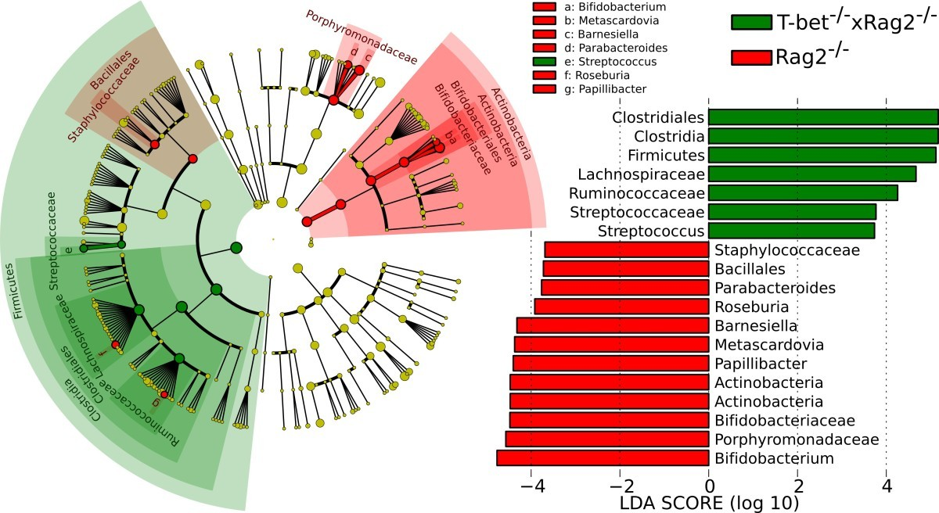
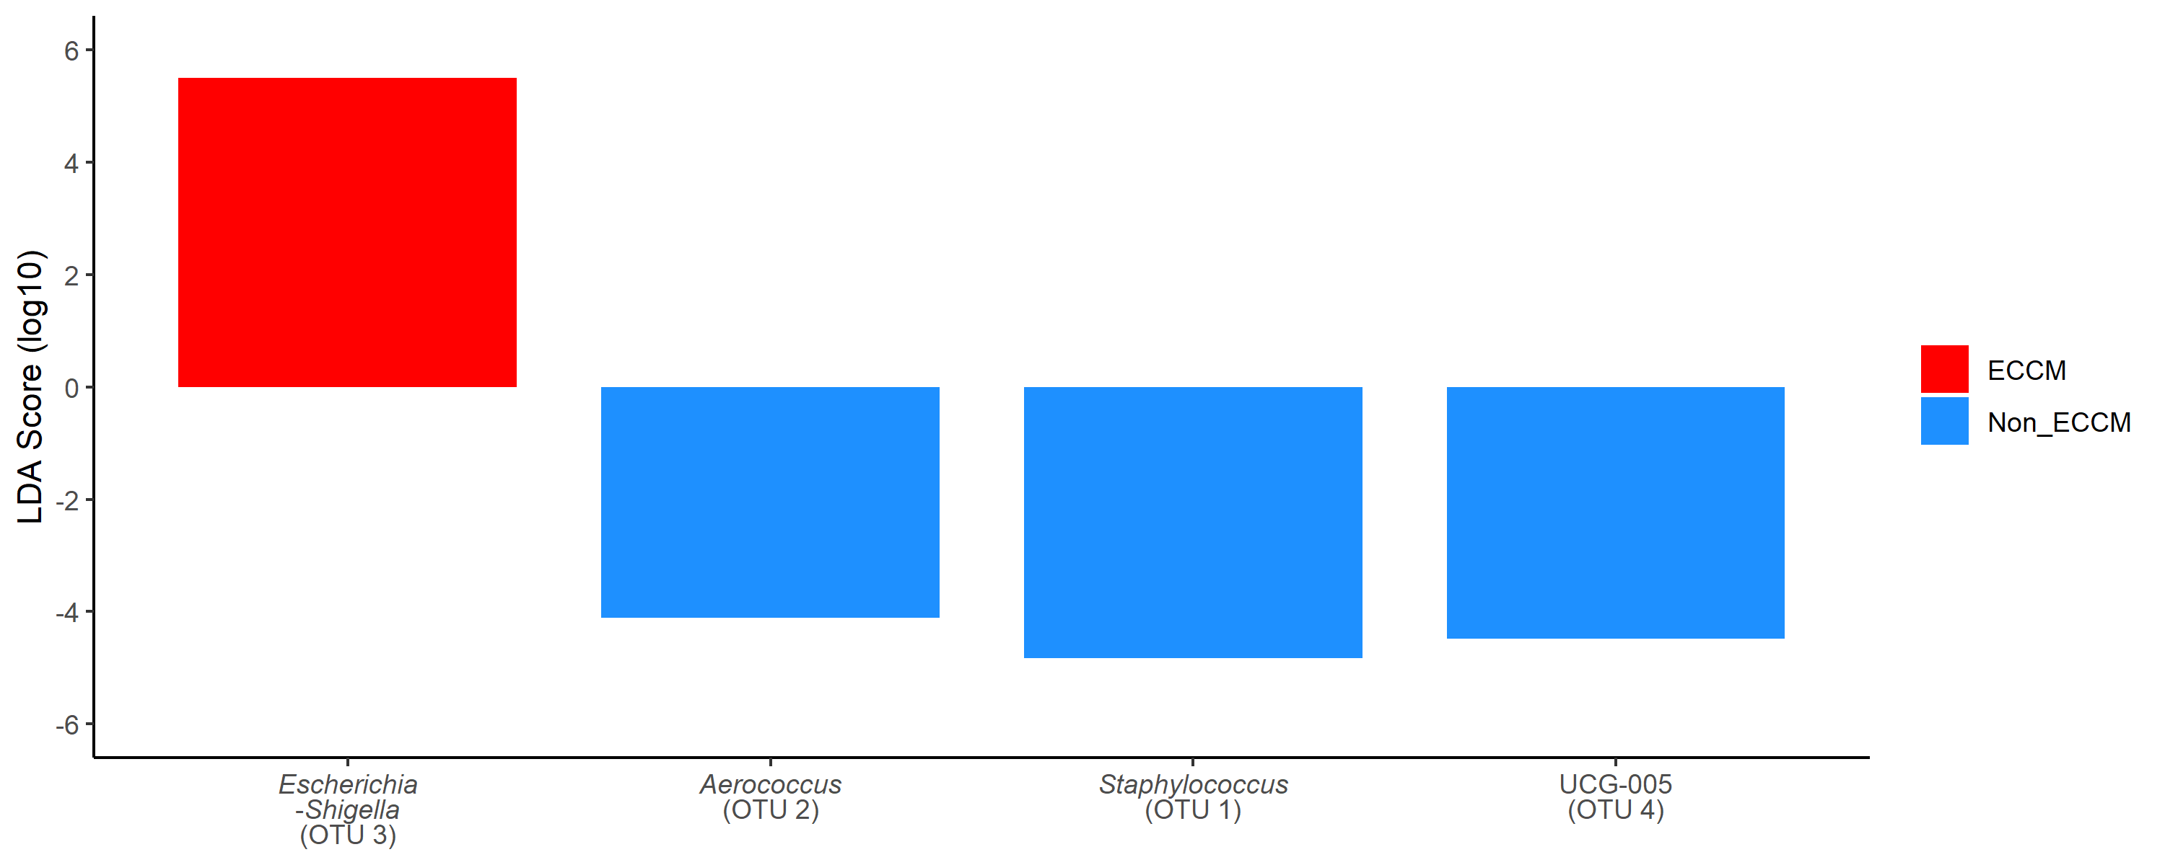
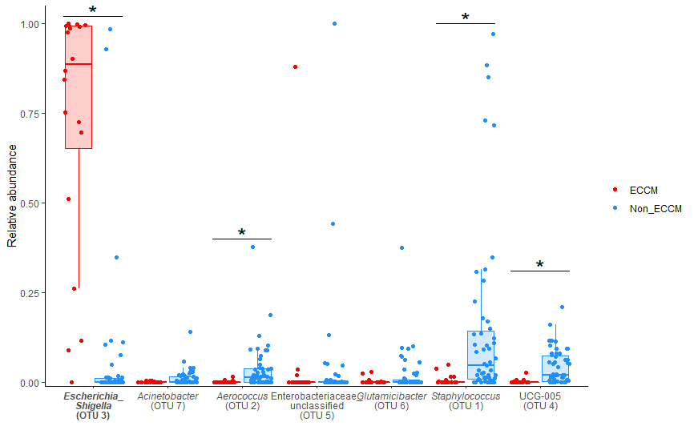
LEfSe
& Wilcoxon rank-sum test
Dongyun Jung
PhD student (C)
Department of Food Science and Agricultural Chemistry
McGill University

Slide 2
Introduction
Introducing the differential abundance analysis
The steps in LEfSe
Kruskal Wallis
Wilcoxon
LDA
Upsides and downsides of LEfse
LEfSe
What can you get?
What is missing?
What is LEfSe
Combination with Wilcoxon
Using both LEfSe and Wilcoxon signed rank sum test
5

Slide 3
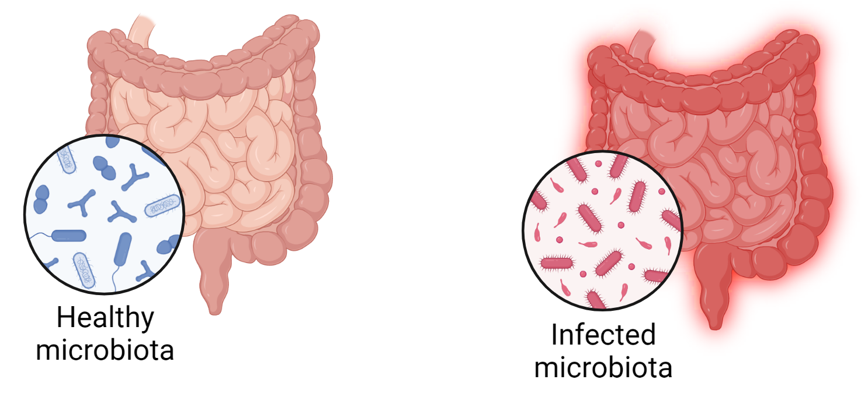
Differences of microbial patterns
Alpha diversity and beta diversity
Microbes of interest
What are the dominant taxa from patient or non-patient?
What are the biomarkers?

Slide 4

Differential abundance analysis
Statistical methods are used to compare microbiome compositions between different classes.
  Potentially biomarkers could be provided?
The microbiome data is compositional leading false negative and positive results.
  Normalization and relative abundance of the features are made.
The samples can be non-parametric (e.g. not distributed equally or not same number of samples).
Several methods and tools have been used to overcome the downsides.
Day 1
Day 10

Slide 5



LEfSe
(Linear discriminant analysis Effect Size)
LEfSe determines the differences of the features (organisms, clades, operational taxonomic units, genes, or functions) between two classes.
LEfSe uses two statistical tests for statistical significance with an additional test encoding biological consistency and effect relevance.
Notes:
Lefse is a traditional soft Norwegian flatbread

Slide 6
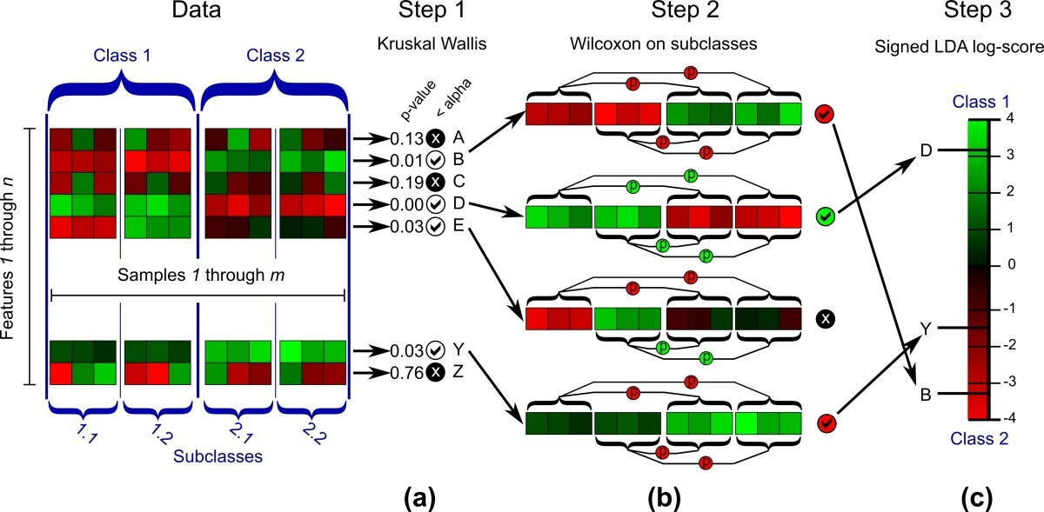
How does LEfSe work?
Segata et al., Genome Biology (2011)

Slide 7
Kruskal Wallis (KW) sum-rank test
KW sum-rank test detects features with significant differential abundance with respect to the class of interest.
  Class 1: non-mucosal, class 2: mucosal
e.g. “Feature 1” is Enterococcus and “Feature 2” is Staphylococcus.
  Feature 2 has 0.01 as p-value (lower than 0.05) which will be tested on Step 2.
  Feature 1 is not further analyzed.
Segata et al., Genome Biology (2011)

Slide 8
Wilcoxon rank sum test
Wilcoxon rank sum test investigates biological consistency of the feature differences among subclasses.
  Subclass 1.1 and 1.2: skin, ear
  Subclass 2.1 and 2.2: gut, oral
All subclasses from two classes must violate the null hypothesis.
The features that passed the Wilcoxon test are considered as biomarkers.
Segata et al., Genome Biology (2011)

Slide 9
LDA score
(Linear Discriminant Analysis)
LDA score is measured by the differences of mean of feature abundance of each class on the linear discriminant axis.
The value is scaled in 1-10⁶ and score is obtained computing the logarithm (base 10).
LDA score is ranked to show biomarker relevance of each feature.
Segata et al., Genome Biology (2011)

Slide 10
Results plots
Cladogram shows the overall biomarker relevance of each feature.
Bar graph shows LDA score of each feature as biomarker.
Segata et al., Genome Biology (2011)

Slide 11
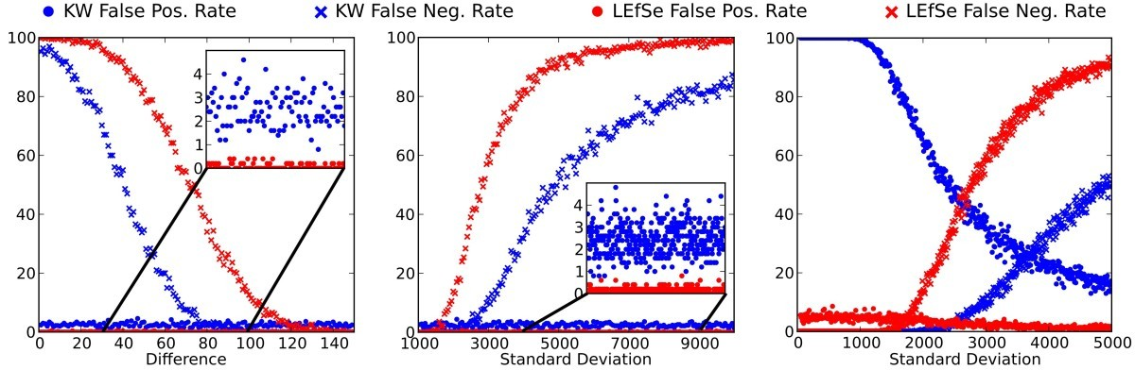
False positive rates
The comparison of LEfSe, KW test and METASTATS for false negative and positive rates.
LEfSe has lower false positive rate and higher false negative rate than KW and METASTATS.
While microbiome data always has false negative due to its compositional nature, false positive causes more impact to the study.
Segata et al., Genome Biology (2011)
Notes:
nonparametric t-test, Fisher’s exact test, and the false discovery rate (FDR)

Slide 12
Downsides of LEfSe
Only two classes can be compared using LEfSe.
  Good for clinical vs non-clinical
  Not for clinical associated with A pathogen vs clinical not associated with A pathogen vs non-clinical
LEfSe only performs KW test if there are no subclasses.
  Loss of discriminatory power
LEfSe actually does discriminatory analysis, but does not really do differential abundance analysis.
  Cannot evaluate the pair-nature of the data

Slide 13
Downsides of LEfSe
(cont’d)
No variation of relative abundance of each feature (No average/median).
Many studies only used LEfSe to compare the features from each class and even conclude them as “biomarkers”.
Notes:
6707 citations since 2011.

Slide 14
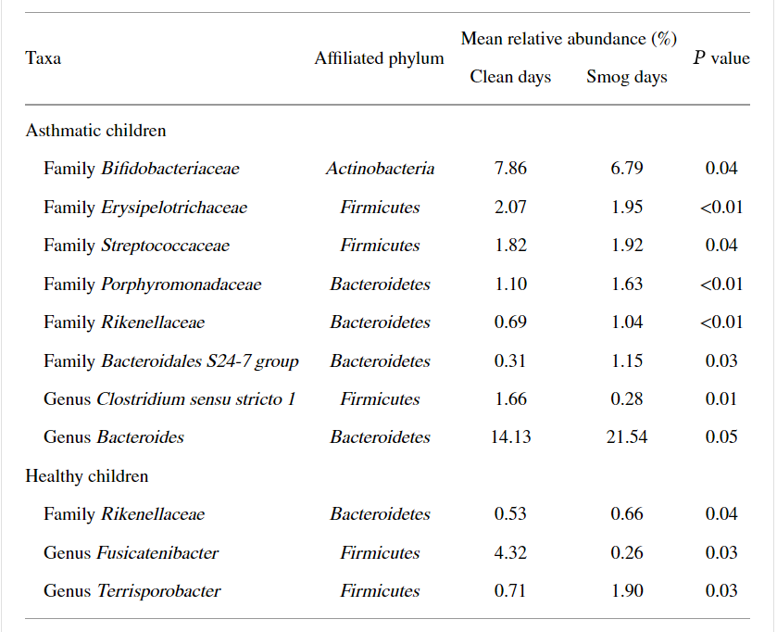
Wilcoxon signed rank sum test
A common non-parametric test for two groups/classes
It is neglected due to its high rate of false negative/positive results.
It commonly used to show the P-value only.
Zheng et al., BioMed Research International (2020)
Notes:
classical statistical methods such as Wilcoxon tests are conservative, controlling type I error but losing power since they fail to fully exploit the data characteristics.

Slide 15
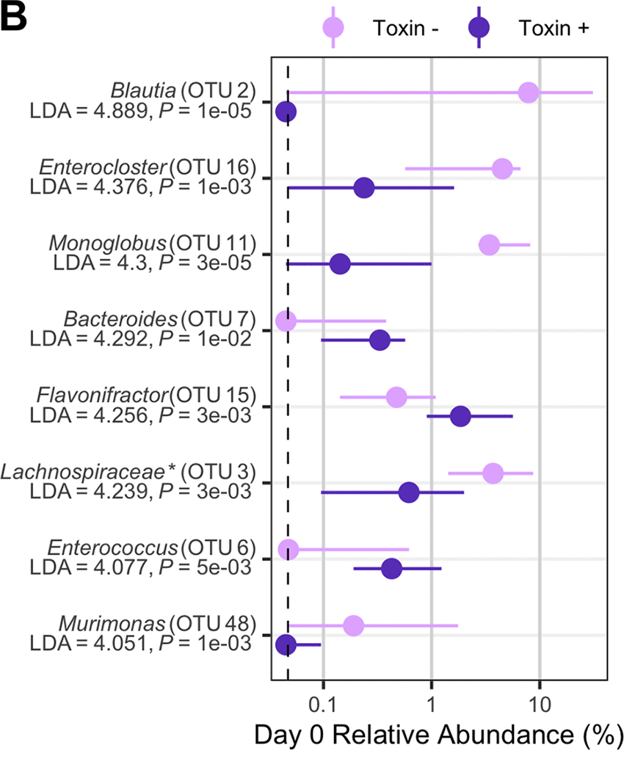
Combination of LEfSe and the Wilcoxon test
Showing the relative abundance of each feature with p-value by the Wilcoxon test and LDA score by LEfSe can be promising.
P-value from the Wilcoxon test can be adjusted by Benjamini-Hochberg (BH) method to correct the false discovery rate.
Lesniak et al., mbio (2022)
Notes:
Relative abundance difference by C. difficile toxin

Slide 16
Combination of LEfSe and the Wilcoxon test
(Cont’d)
Run LEfSe and find the features that have significant LDA scores.
Visualize the relative abundance of these features and run Wilcoxon test on them.
Analyze the plot to identify the variation of relative abundance of these features depending on the factors such as the disease of interest or treatments.

Slide 17
Summary
Differential abundance analysis is affected by compositionality and always done by relative abundance of the features after normalization.
LEfSe is one of the methods for effective differential abundance analysis which minimizes false positive rates.
LDA scores can indicate the potential biomarkers due to its discriminatory nature.
LEfSe cannot evaluate the pair-nature of the microbiome data
Combination of Wilcoxon signed rank sum with BH correction and LDA scores on relative abundance of the features of interest can both perform differential abundance analysis and identify the potential biomarkers.

Slide 18


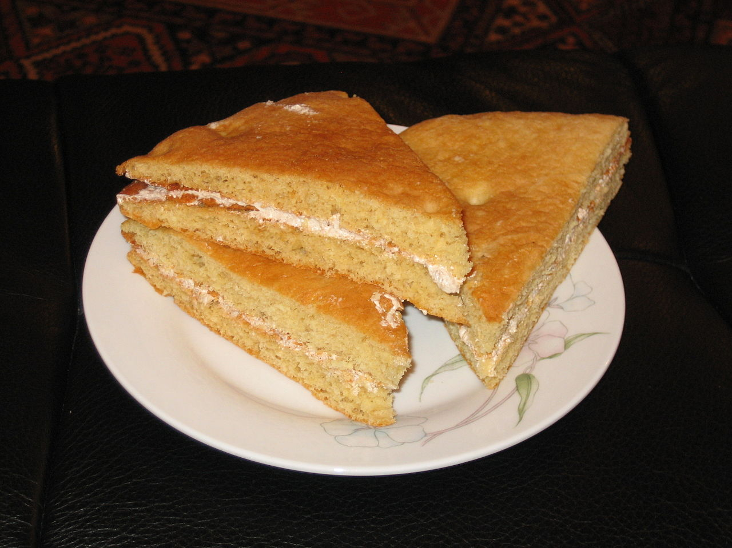
Thank you
It’s all about how you use and make it!
dongyun.jung@mail.mcgill.ca

