Slide 1
A brief introduction to ASVs
Esteban Góngora
PhD Candidate in Microbiology
Department of Natural Resource Sciences, McGill University
Theory of Microbiome Analysis Workshop
October 3, 2022

Slide 2
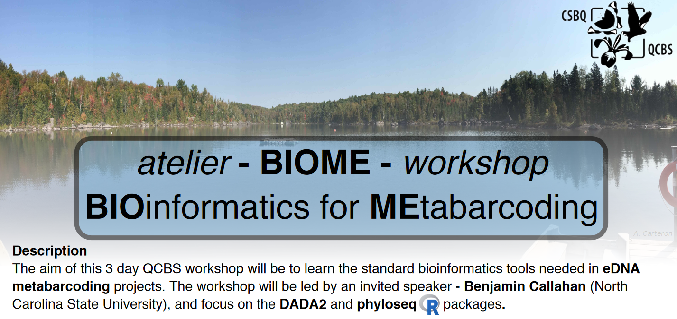

Acknowledgement
Publicly available here!

Slide 3
Sample sequences
(real species)
Operational Taxonomic Units
Amplicon reads
PCR amplification + Sequencing
OTU assignment

Slide 4
Sample sequences
(real species)
Now we have different OTUs!
Amplicon reads
PCR amplification + Sequencing
OTU assignment

Slide 5
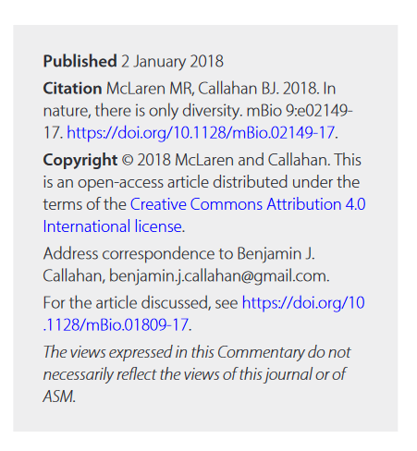
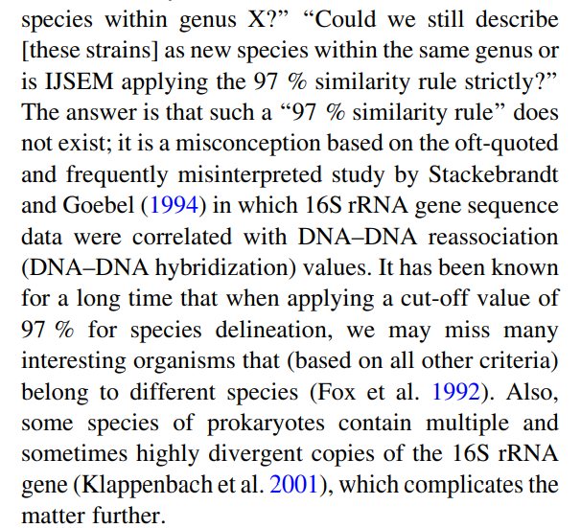
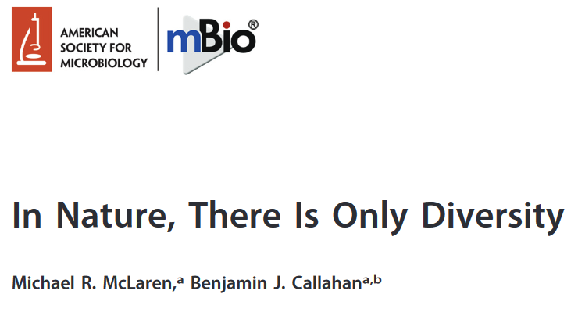
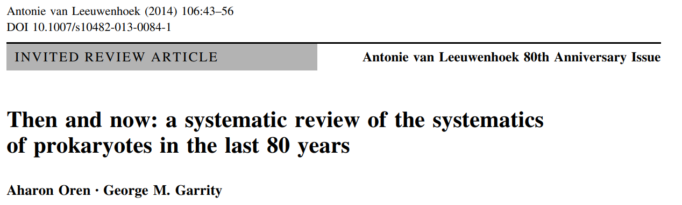
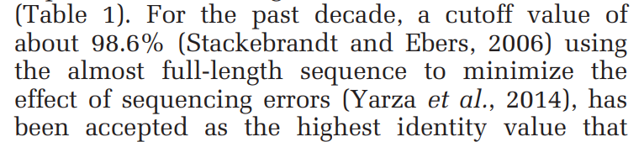
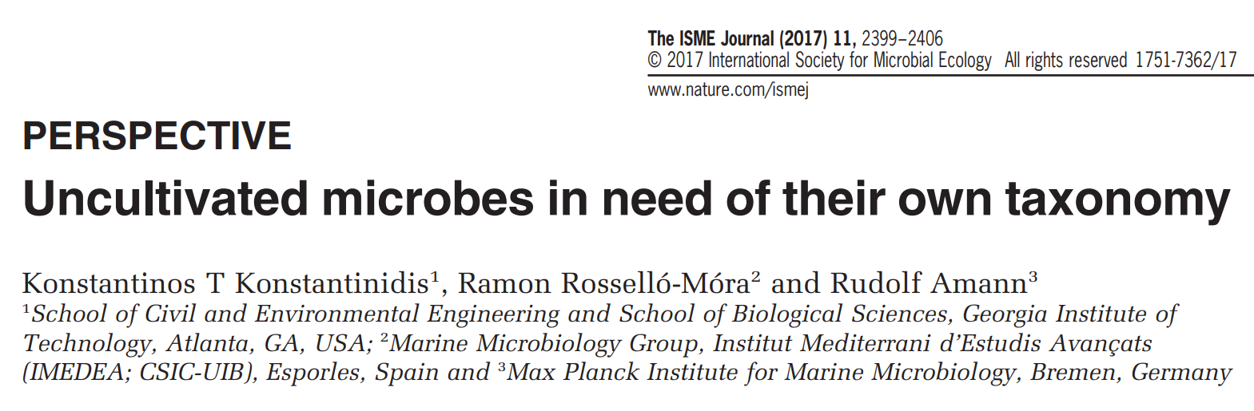
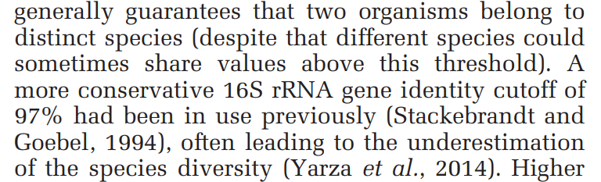
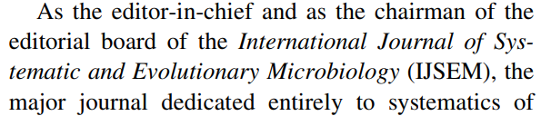
Some other issues with OTUs
→ OTU2 is not a consistent label across studies
→ OTU2 is in another community? OTUs don’t exist in nature
→ OTU2 represents a species? Not always
2
1
3
1
2
4

Slide 6
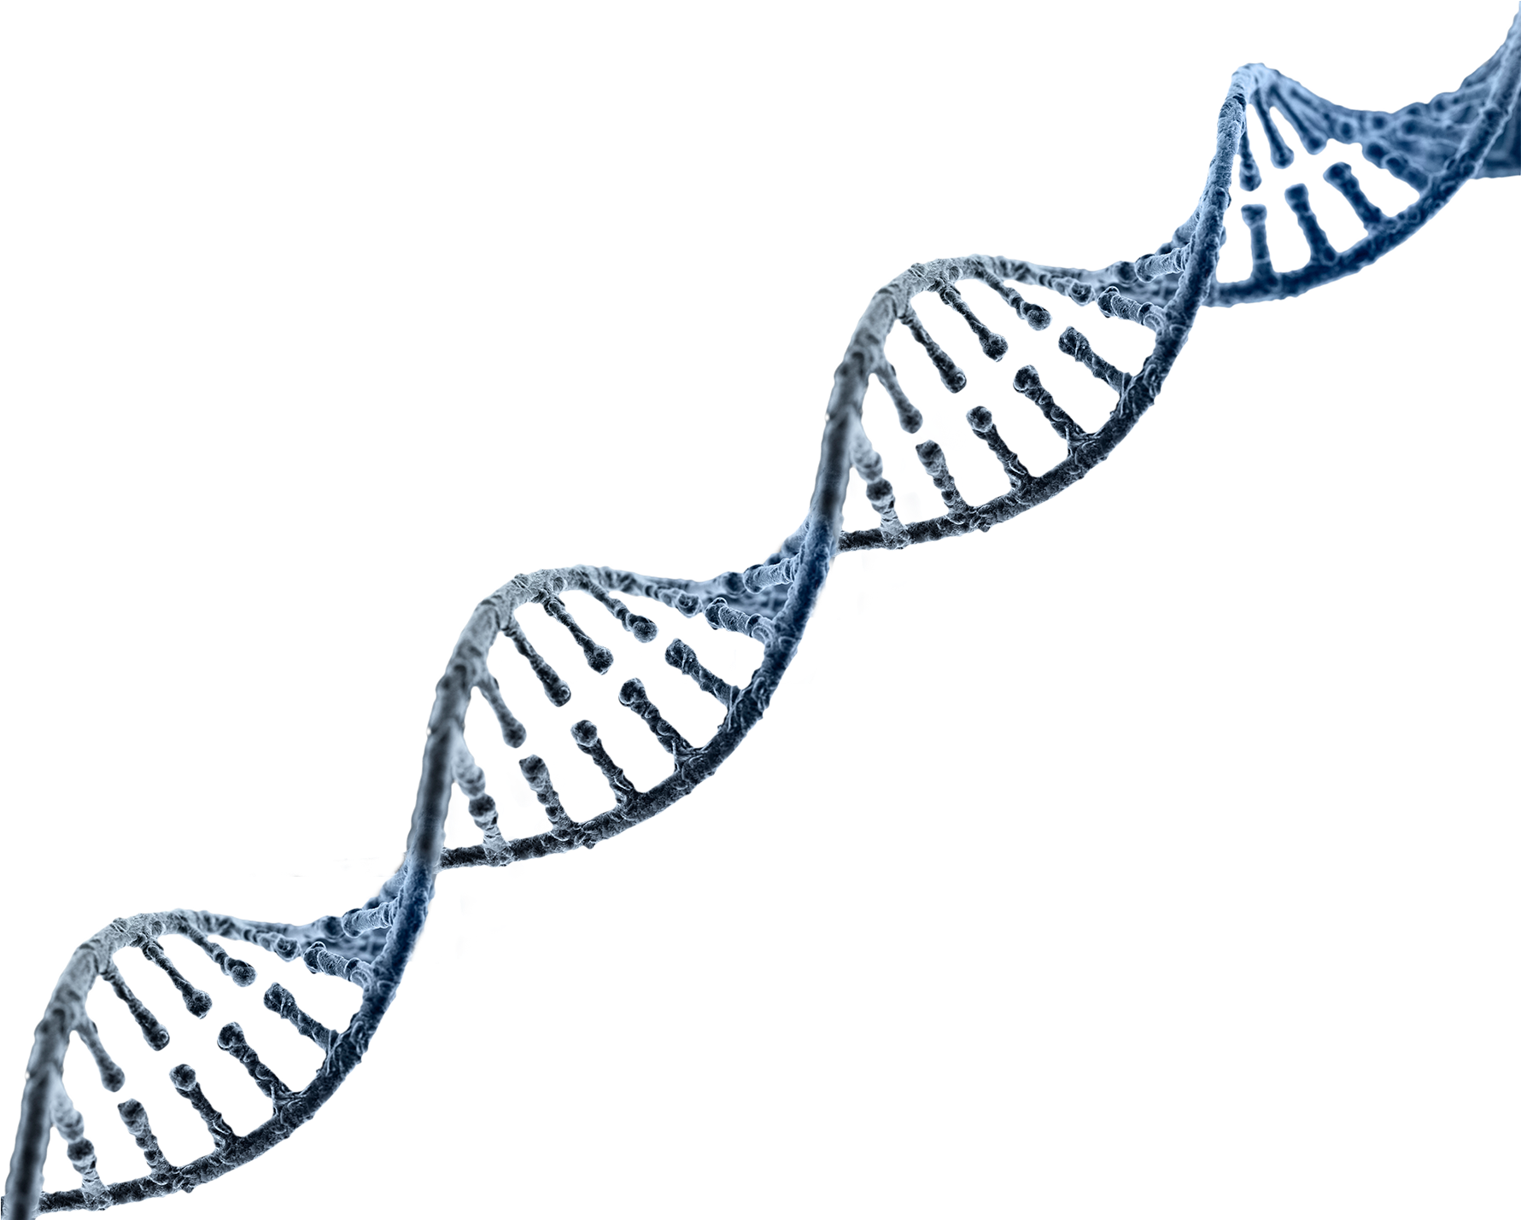
What should we do with our sequences then?
OTU2 is not a consistent label
However…
ATTAACGAGATTATAACCAGAGTACGAATA…
is consistent!
→ If we use distinguishable sequences as the groups, then it is easy to compare data across multiple studies and databases
→ This is the idea behind an amplicon sequence variant (ASV)
→ Also known as Exact SV (ESVs), 100% OTUs, zero radius OTUs (zOTUs), among others

Slide 7
Sample sequences
(real species)
Now we have different OTUs!
Amplicon reads
PCR amplification + Sequencing
OTU assignment
Try to infer sample sequences

Slide 8
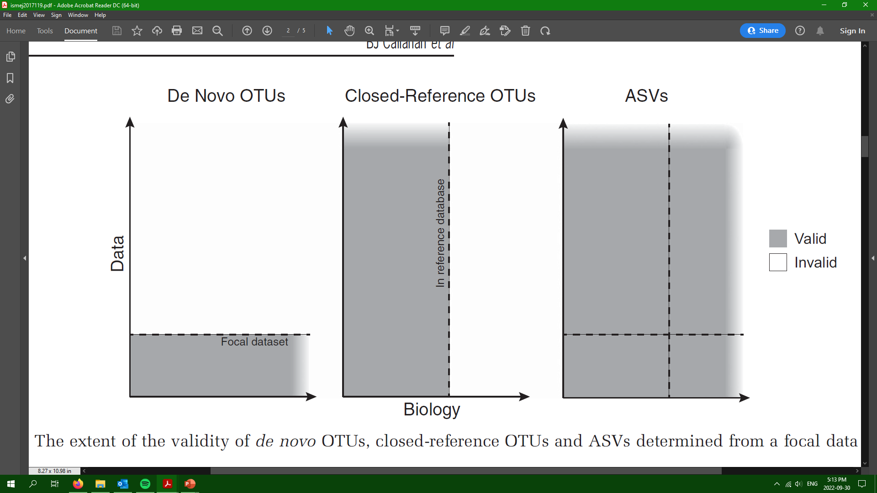
ASVs are always valid and comparable

Slide 9
A common misconception about ASVs
If I obtain 1273 OTUs/ASVs it means I have 1273 species
→ A different ASV does not necessarily equal a different species
→ ASVs are only telling us that “sequence 1” is real (not an artifact) and that it is distinguishable from “sequence 2”, “sequence 3”, etc.
→ We then have to assign the taxonomy to the sequences

Slide 10
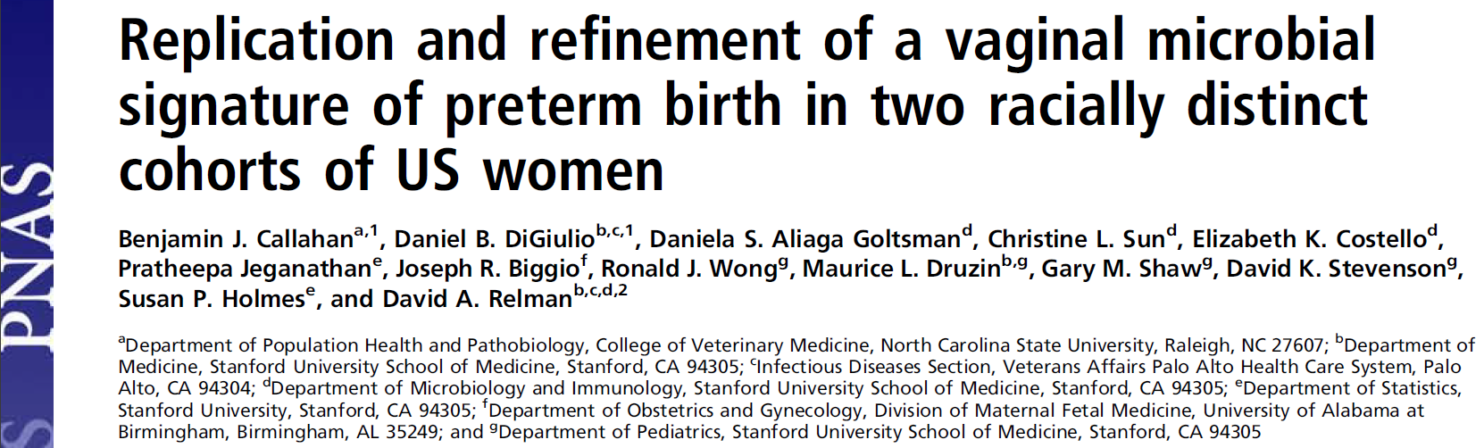
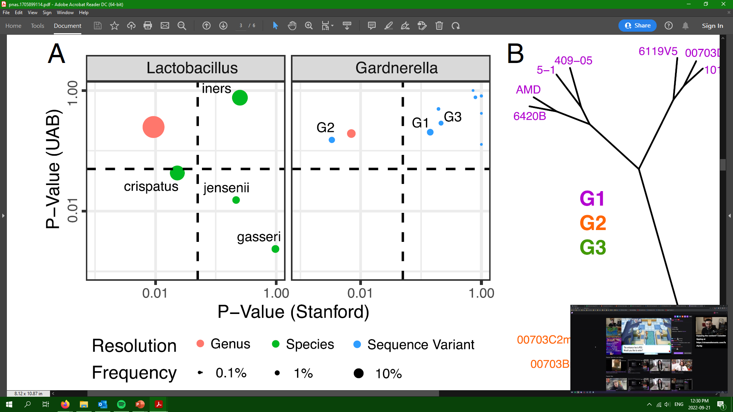
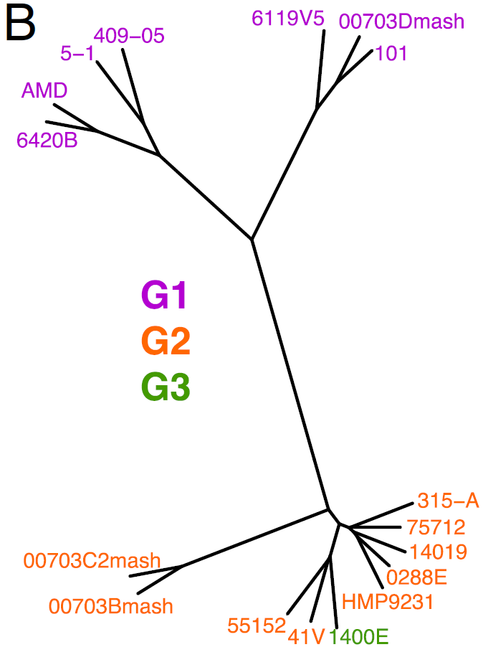

Slide 11
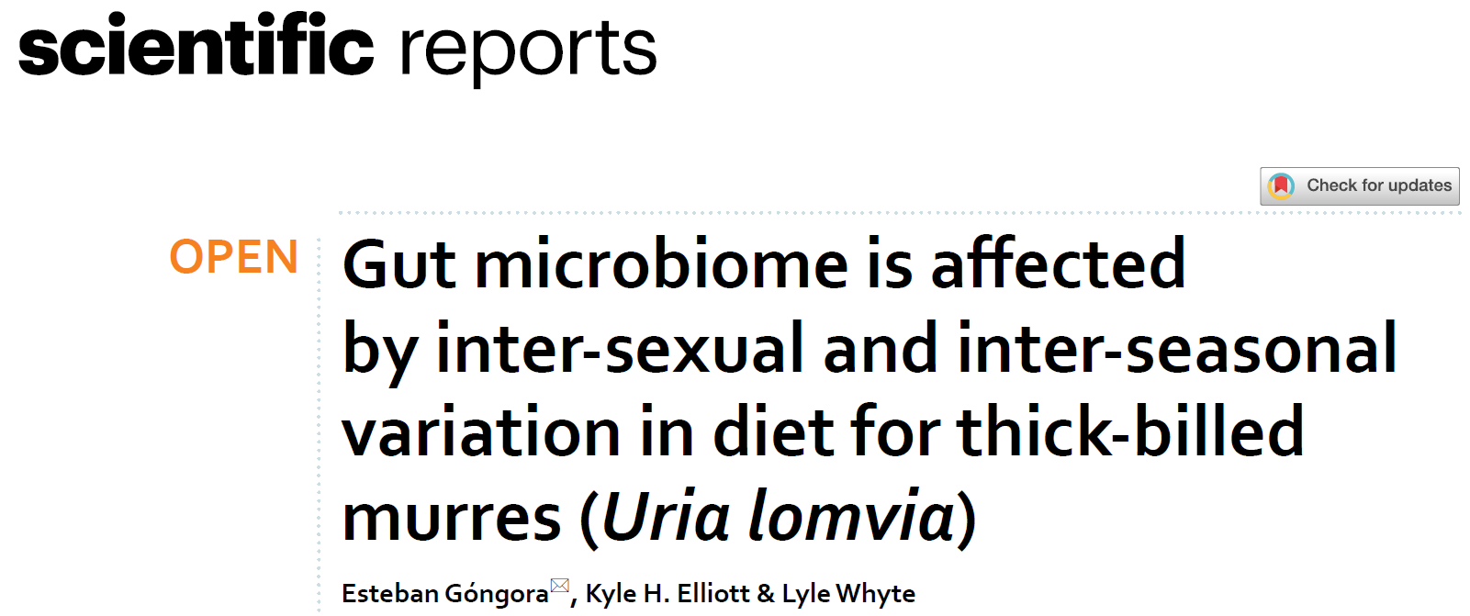
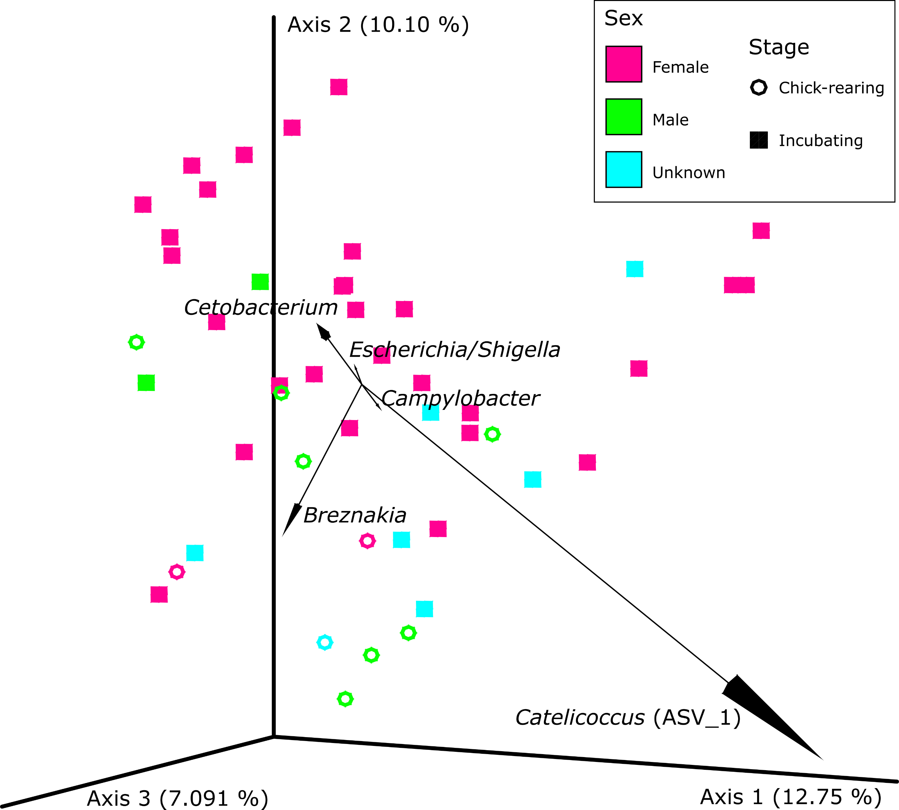
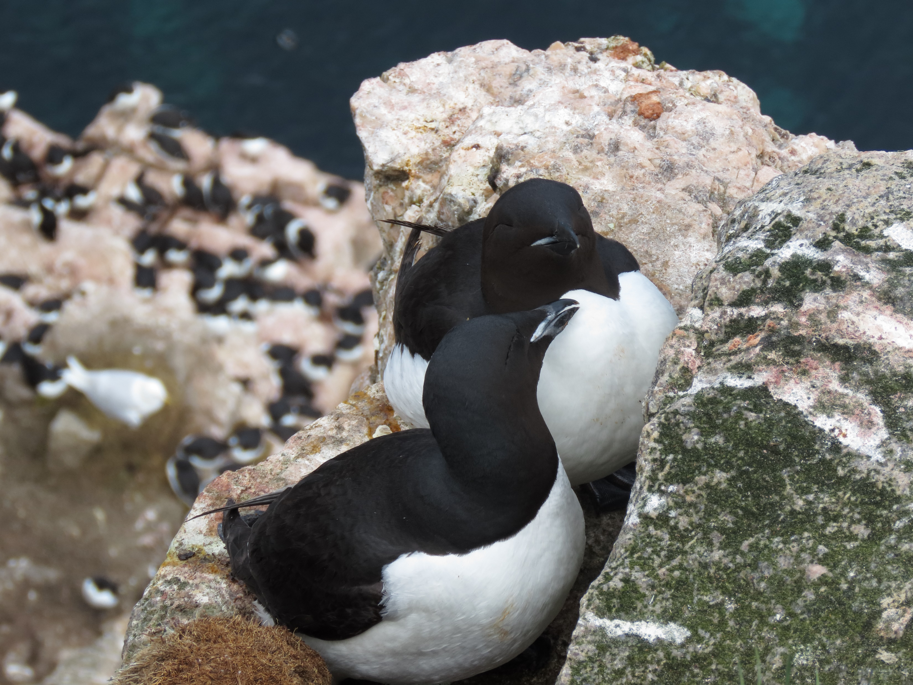

Slide 12
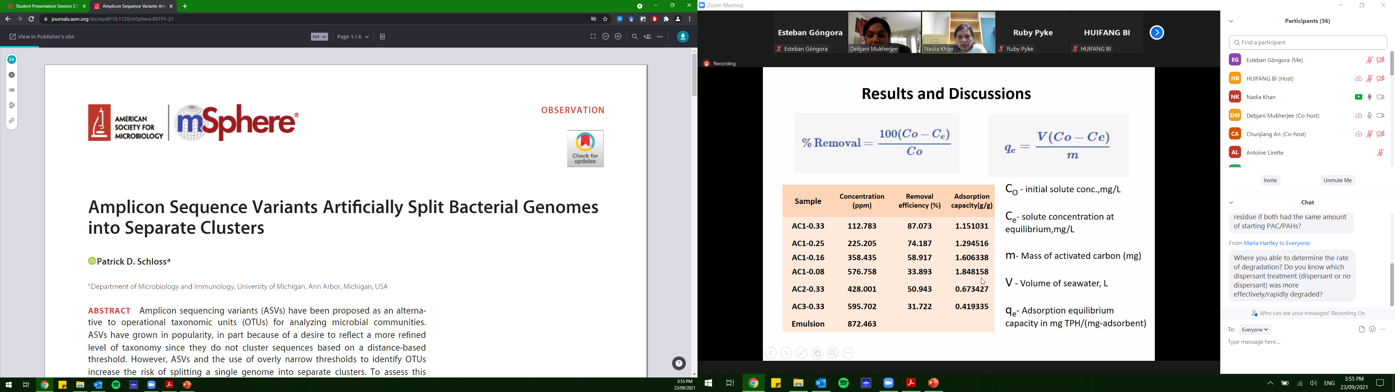
Let’s discuss the pros and cons of both methods
- Staphylococcus aureus (NCTC 8325) and Staphylococcus epidermidis (ATCC 12228) each have 5 copies of the 16S rRNA gene
→Each copy of the gene is distinct and therefore would represent 10 ASVs
→ Clustering at 97% similarity will result in a single OTU for all 10 copies
- Potentially discarding real sequences present in low abundance?
- Can we classify a sequence up to species using only hundreds of base pairs?
What is even a (microbial) species?

