Slide 1
Rarefaction
Bridget O’Brien
Theory of Microbiome Analysis Workshop
October 3, 2022

Slide 2
Clustered Sequence Tables
Microbial community sequencing data is typically organized into large matrices
Columns = Samples
Rows = Observed counts of clustered sequences (OTU, ASV)
 | Sample_1 | Sample_2 | Sample_3 | Sample_4
OTU001 | 12 | 47 | 306 | 467
OTU002 | 136 | 2008 | 6 | 32
OTU003 | 86 | 146 | 4037 | 0
OTU004 | 1027 | 300 | 87 | 22

Slide 3
Library sizes can vary widely among samples
Library size = Total number of reads in a sample
  Can vary widely among different samples
    This variation does not indicate any differences in microbial communities (two replicate samples can be sequenced and result in 4000 and 16,000 reads in each)
 | Sample_1 | Sample_2 | Sample_3 | Sample_4
OTU001 | 12 | 47 | 306 | 467
OTU002 | 136 | 2008 | 6 | 32
OTU003 | 86 | 146 | 4037 | 0
OTU004 | 1027 | 300 | 87 | 22
Library Size:
1261
2501
4436
521

Slide 4
Library sizes can vary widely among samples
Library size = Total number of reads in a sample
  Can vary widely among different samples
    This variation does not indicate any differences in microbial communities (two replicate samples can be sequenced and result in 4000 and 16,000 reads in each)
Variation in library sizes may be due to:
  Different amounts of DNA loaded for sequencing
  Primer bias
  Extraction efficiencies
Libraries with different sizes can lead to inaccurate diversity analysis conclusions
  A sample with more reads may appear to be more diverse than a sample with less reads (because more sequences are present)

Slide 5
A normalization tool: Rarefaction
Rarefaction:
  Reduces the number of reads to a size shared among several samples through random sub-sampling of the reads
    Allows for sample comparison without bias from differences in sample size
 | Sample_1 | Sample_2 | Sample_3 | Sample_4
OTU001 | 12 | 47 | 306 | 467
OTU002 | 136 | 2008 | 6 | 32
OTU003 | 86 | 146 | 4037 | 0
OTU004 | 1027 | 300 | 87 | 22

Slide 6
A normalization tool: Rarefaction
Rarefaction:
  Reduces the number of reads to a size shared among several samples through random sub-sampling of the reads
    Allows for sample comparison without bias from differences in sample size (kind of)
OTU001
Sample_1
Sample_2
Sample_3
Sample_4
OTU002
Original
OTU003
OTU004
OTU001
Sample_1
Sample_2
Sample_3
Sample_4
OTU002
Rarified
OTU003
OTU004

Slide 7
Deciding what library size to rarify to
Can be determined through the examination of rarefaction curves
  The number of sequence variants (or OTUs) plotted against the number of samples
  Created by randomly re-sampling the pool of N samples several times and then plot the average number of sequence variants found on each sample
By selecting a library size that encompasses the flattening portion of the curve for each sample, it is generally assumed that the normalized library size will adequately capture the diversity within the samples despite the exclusion of sequence reads during the rarefying process

Slide 8
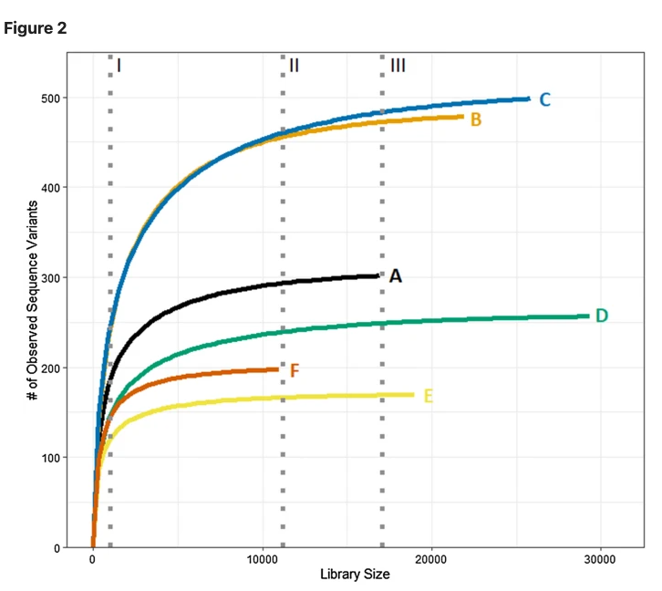
Rarefaction Curves
Omits many sequence variants
Omits the fewest sequences and can even omit entire samples
Omits fewer sequence variants
Source: Cameron et al., 2021
Notes:
Selection of unnecessarily small library sizes (I) omits many sequence variants. Rarefying to the smallest library size (II) omits fewer sequences and variants. While selection of a larger normalized library size (III) would omit even less sequences, it is necessary to omit entire samples (e.g., Sample F) that have too few sequences).
By selecting a library size that encompasses the flattening portion of the curve for each sample, it is generally assumed that the normalized library size will adequately capture the diversity within the samples despite the exclusion of sequence reads during the rarefying process

Slide 9
Rarefaction has problems
Typically conducted in single iteration and therefore only provides a snapshot of the community that might be observed
Introduces artificial variation to data by omitting a random subset of observed sequences
Necessitates discarding samples with library sizes deemed too small (have to throw away samples)
Possible solution: Repeatedly rarefying

Slide 10
A normalization tool: Repeated Rarefaction
Original
Rarified
OTU001
Sample_2
OTU002
OTU003
OTU004

Slide 11
A normalization tool: Repeated Rarefaction
Original
Rarified
OTU001
Sample_2
OTU002
OTU003
OTU004

Slide 12
A normalization tool: Repeated Rarefaction
Original
Rarified
OTU001
Sample_2
OTU002
OTU003
OTU004

Slide 13
A normalization tool: Repeated Rarefaction
Original
Rarified
OTU001
Sample_2
OTU002
OTU003
OTU004

Slide 14
A normalization tool: Repeated Rarefaction
Original
Rarified
OTU001
Sample_2
OTU002
OTU003
OTU004

Slide 15
A normalization tool: Repeated Rarefaction
Original
Rarified
OTU001
Sample_2
OTU002
OTU003
OTU004

Slide 16
A normalization tool: Repeated Rarefaction
Original
Rarified
OTU001
Sample_2
OTU002
OTU003
OTU004

Slide 17
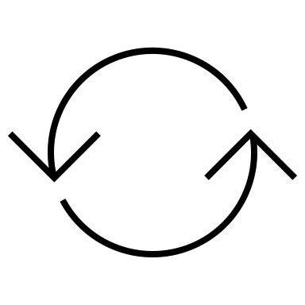
A normalization tool: Repeated Rarefaction
Original
Rarified
OTU001
Sample_2
OTU002
OTU003
1000 X
OTU004
Using “thrown-out” data in the process

Slide 18
My Dataset: The Milk Microbiome
Low biomass
Very sparse (lots of observations with read count of 0)
Large differences in library size (>10X)
Want to compare different normalization techniques on my dataset
  1. Created a null community model
    There will be samples which are distant from each other due to the community structure (healthy milk vs milk from mastitis infections)
    Want to make an overall sample of what the community looks like
    Take out original data, pool it together, then re-distribute it randomly to make a statistical sampling of that community
      Same number of samples with the same number of reads per sample

Slide 19
One point = the comparison between two samples
Non-Rarified
Rarified
Euclidean Distance
Difference in library size
Without doing any normalization to your data, the distance between samples is largely driven by the difference in library size

Slide 20
One point = the comparison between two samples
Rarified
Robust CLR Transformation
Zero input CLR Transformation
Euclidean Distance
Difference in library size
Although the average distance between samples is reduced using transformation, a linear trend can still be observed
Notes:
Using Euclidean distance because when you transform the data with CLR, to get the Aitchison distance, you need Euclidean.

Slide 21
Conclusions
Without doing any normalization to your data, the distance between samples is largely driven by the difference in library size
Correcting for compositionality (CLR transformation) in milk microbiome dataset doesn’t really help differences in sampling effort
Differences in sampling effort will effect the dataset
May lead to false positives

