Slide 1
Theory of Microbiome Analysis Workshop
Differential Abundance Methods: edgeR
Yao Lu
PhD Candidate
Department of Microbiology and Immunology
Micgill University
2022-Oct-03

Slide 2
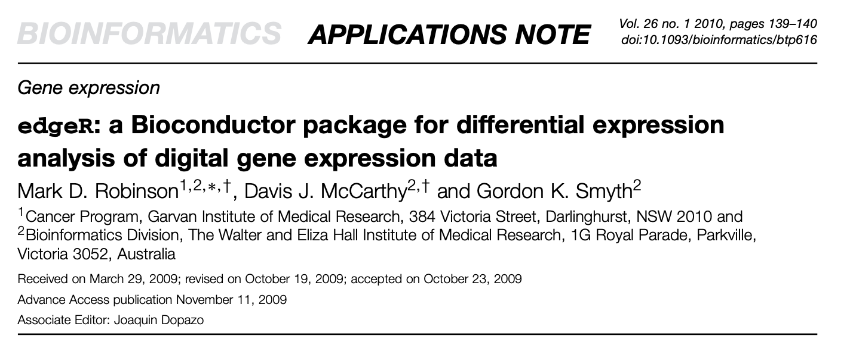

edgeR - Empirical analysis of Digital Gene Expression in R

Slide 3
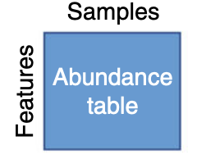
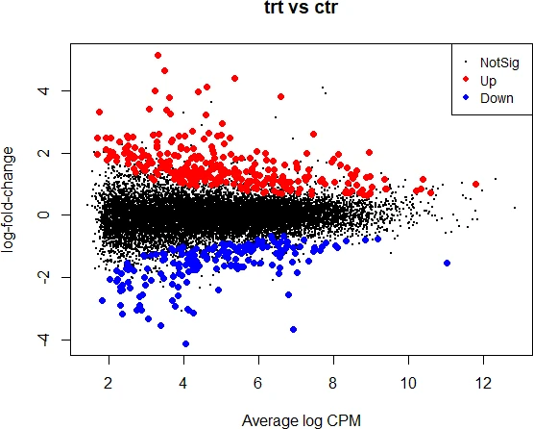

Goal:
To identifying differentially abundant features in microbiome data between conditions of interest
Count
table

Slide 4
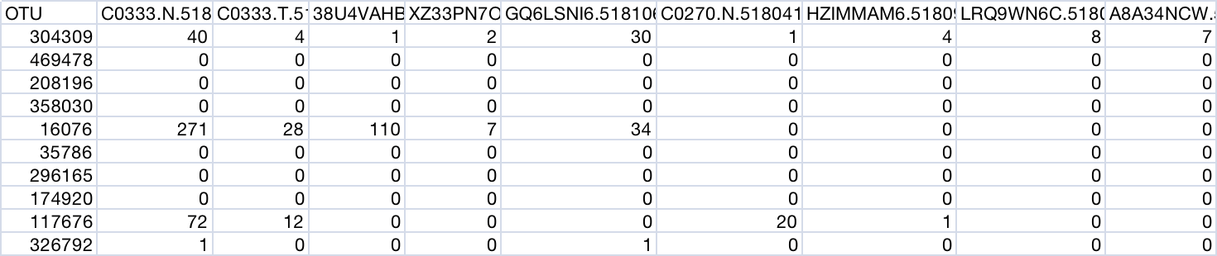
Input:
A study on colorectal cancer
Count table
Group info
Example from: https://joey711.github.io/phyloseq-extensions/edgeR.html
Kostic, A. D.(2012). Genome research, 22(2), 292-298

Slide 5
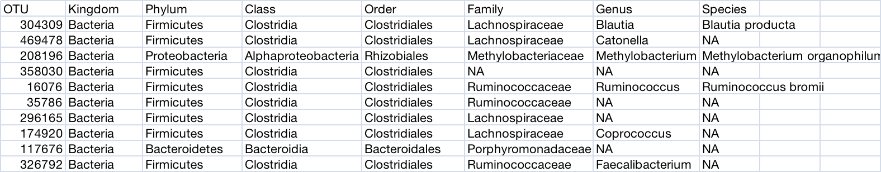
Input:
Taxonomy table
Fusobacteriums were reported to be prevalent in human colorectal carcinoma.obacterium
Example from: https://joey711.github.io/phyloseq-extensions/edgeR.html
Kostic, A. D.(2012). Genome research, 22(2), 292-298

Slide 6
Filtering:
Low count filter：low counts across all libraries provide little evidence for differential expressionfeatures which are likely due to sequencing errors or low-level contaminations.
e.g. 4 counts in at least 20% samples
Low variance filter： features that are close to constant throughout the experiment conditions are unlikely to be associated with the conditions under study
e.g. a variance threshold of 10⁻⁵.

Slide 7
Normalization:
Sequencing depth :
automatically in the basic modeling procedure
Effective library sizes
normalizes the read counts for varying library sizes (sample-specific effect) by finding
a set of scaling factors for the library sizes that minimizes the log-fold changes between
the samples for most features.
TMM is used as defalut to calculate the scaling factors.
The effective library size replaces the original library size in all downsteam analyses.
Note: No transformation (e.g. RPKM or FPKM values) and no artificial values adding before inputing to edgeR. Only original counts are accepted.

Slide 8
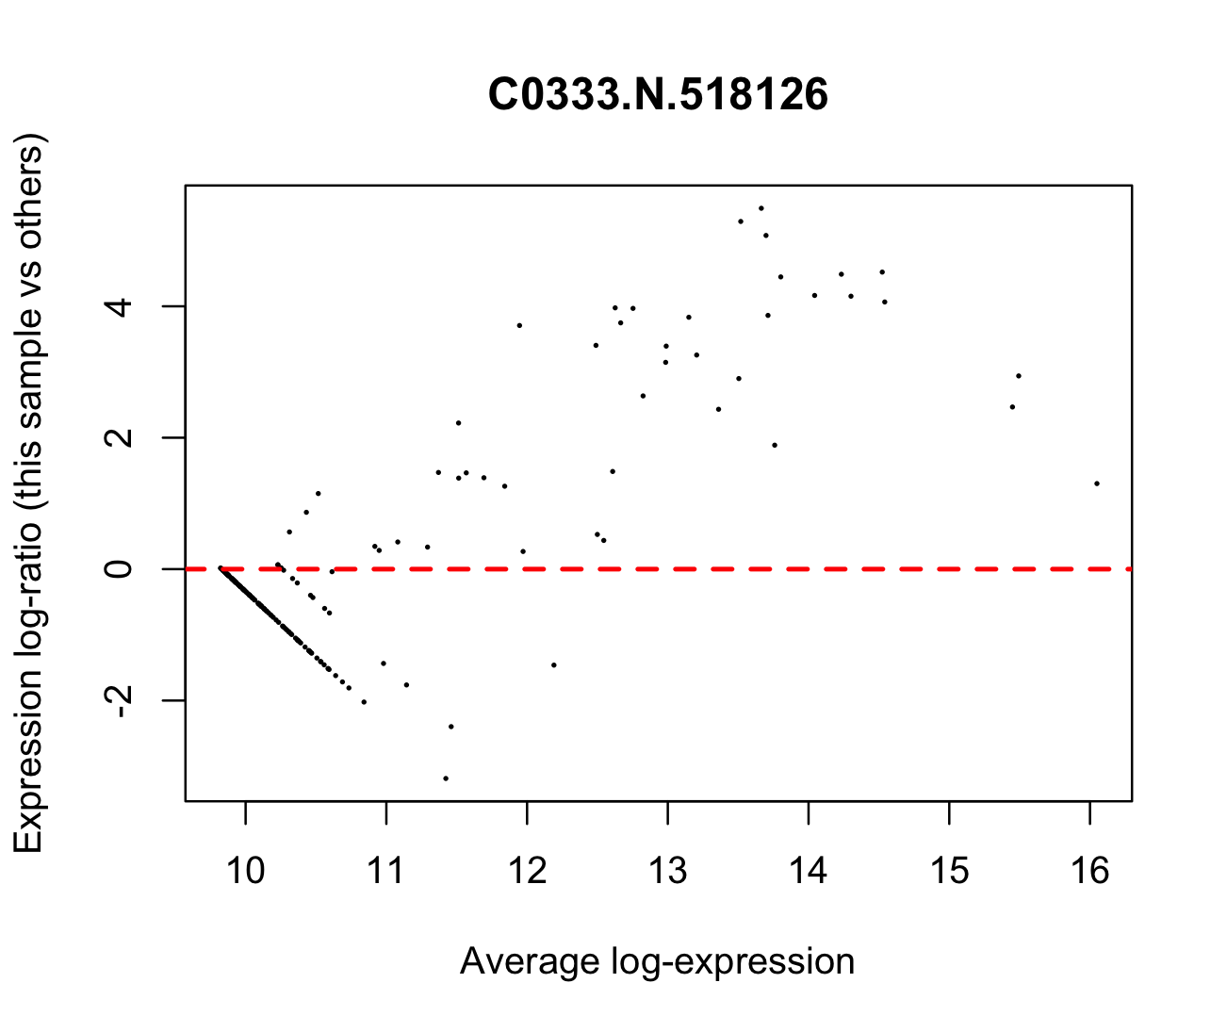
An example of normlization result

Slide 9
Statistics:
Assumption: read counts follow a negative binomial probability law
Classic approach:
quantile-adjusted conditional maximum likelihood (qCML) method:
- single-factor design expression analysis
- more robust
- direct pairwise comparison
Generalized linear models(GLMs) approach:
- multiple factors analysis
- need to fit negative binomial generalized linear models with a design matrix

Slide 10
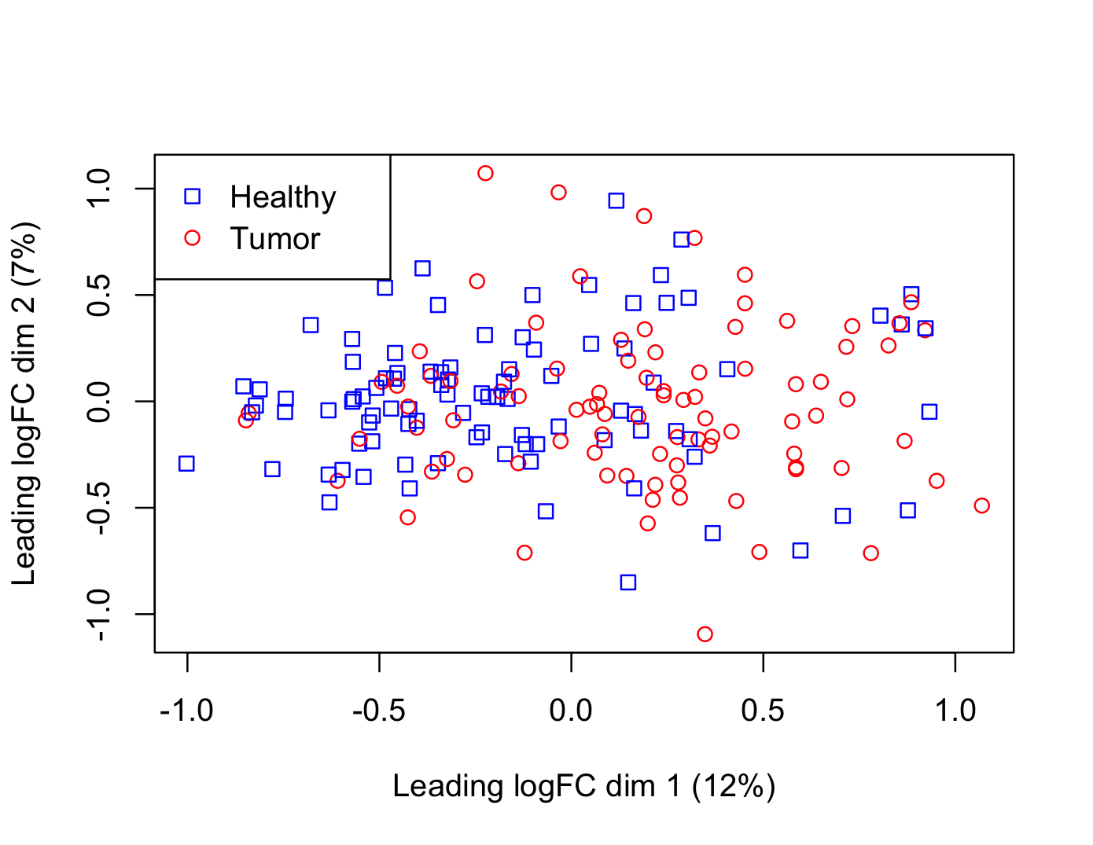
Estimating the dispersion:
Dispersion is a major parameter using the negative binomial model measuring the degree of inter-library variation for each tag. Estimating the common dispersion gives an idea of overall variability across the dataset.
Note: biological replicates are need for dispersion estimation

Slide 11
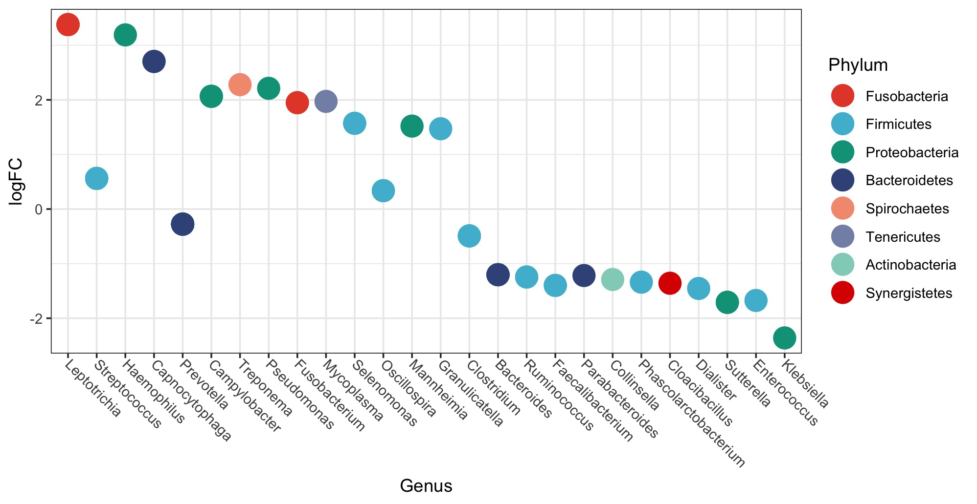
Differential results:

Slide 12
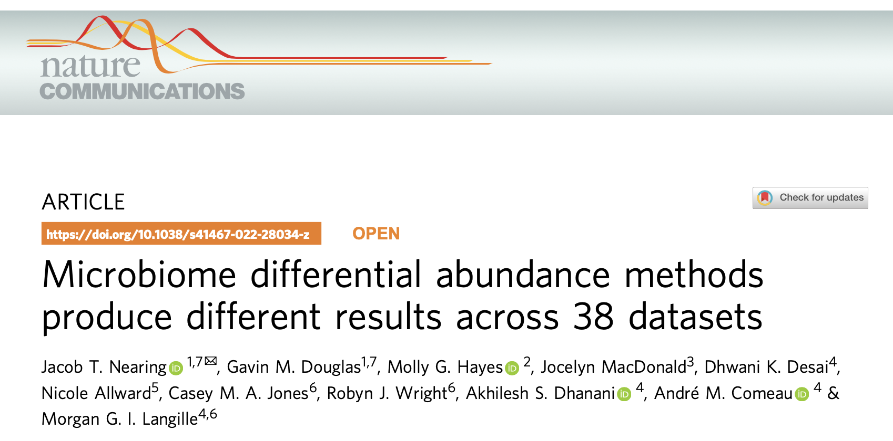
Compare with other methods I:

Slide 13
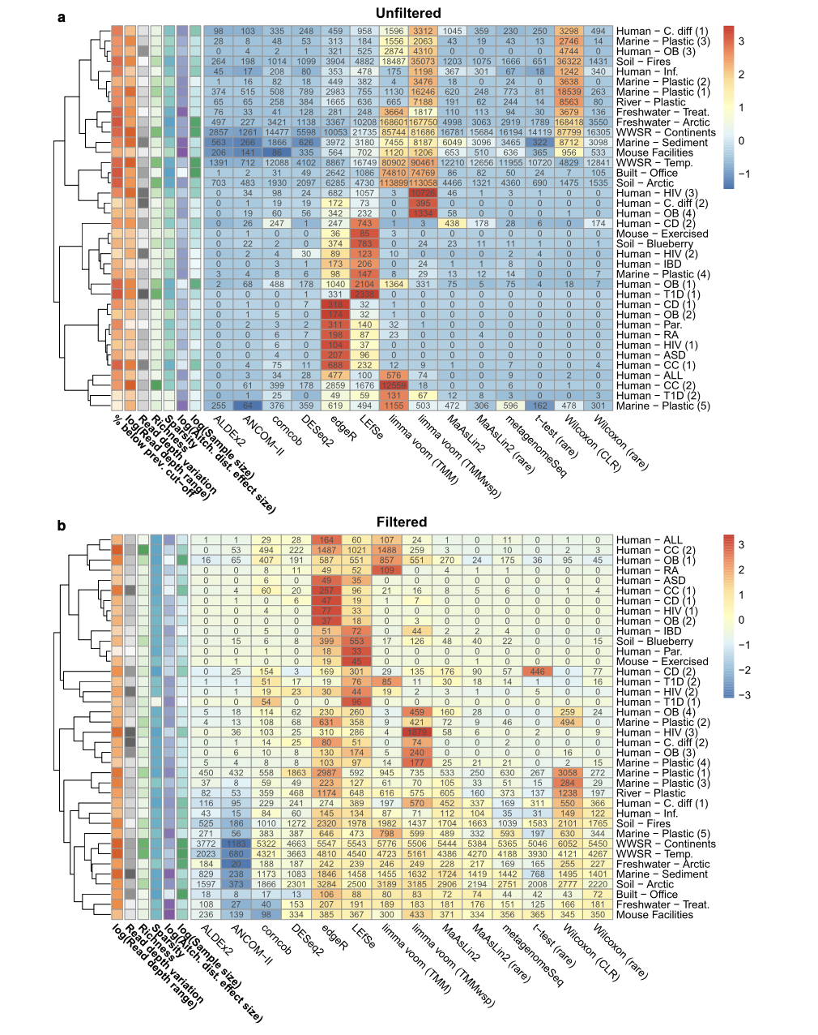
Fig. 1 Variation in the proportion of significant features depending on the differential abundance method and dataset.

Slide 14
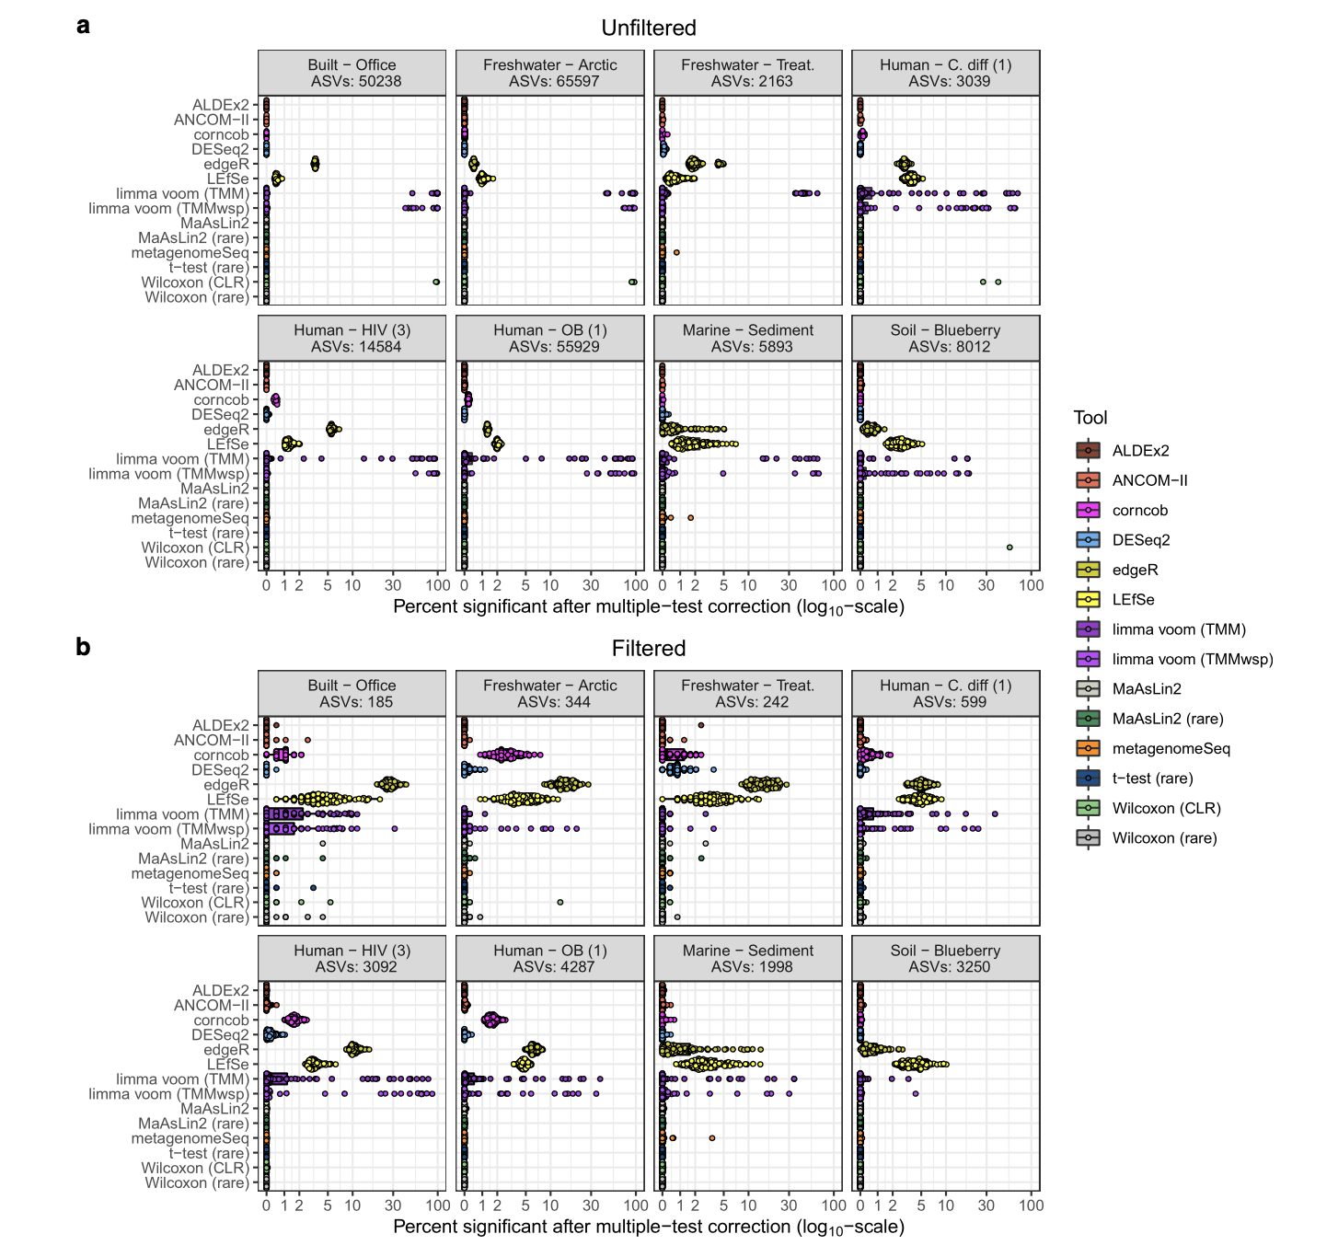
Fig. 4 Distribution of false discovery rate simulation replicates for both unfiltered and filtered data.

Slide 15

Compare with other methods II:

Slide 16
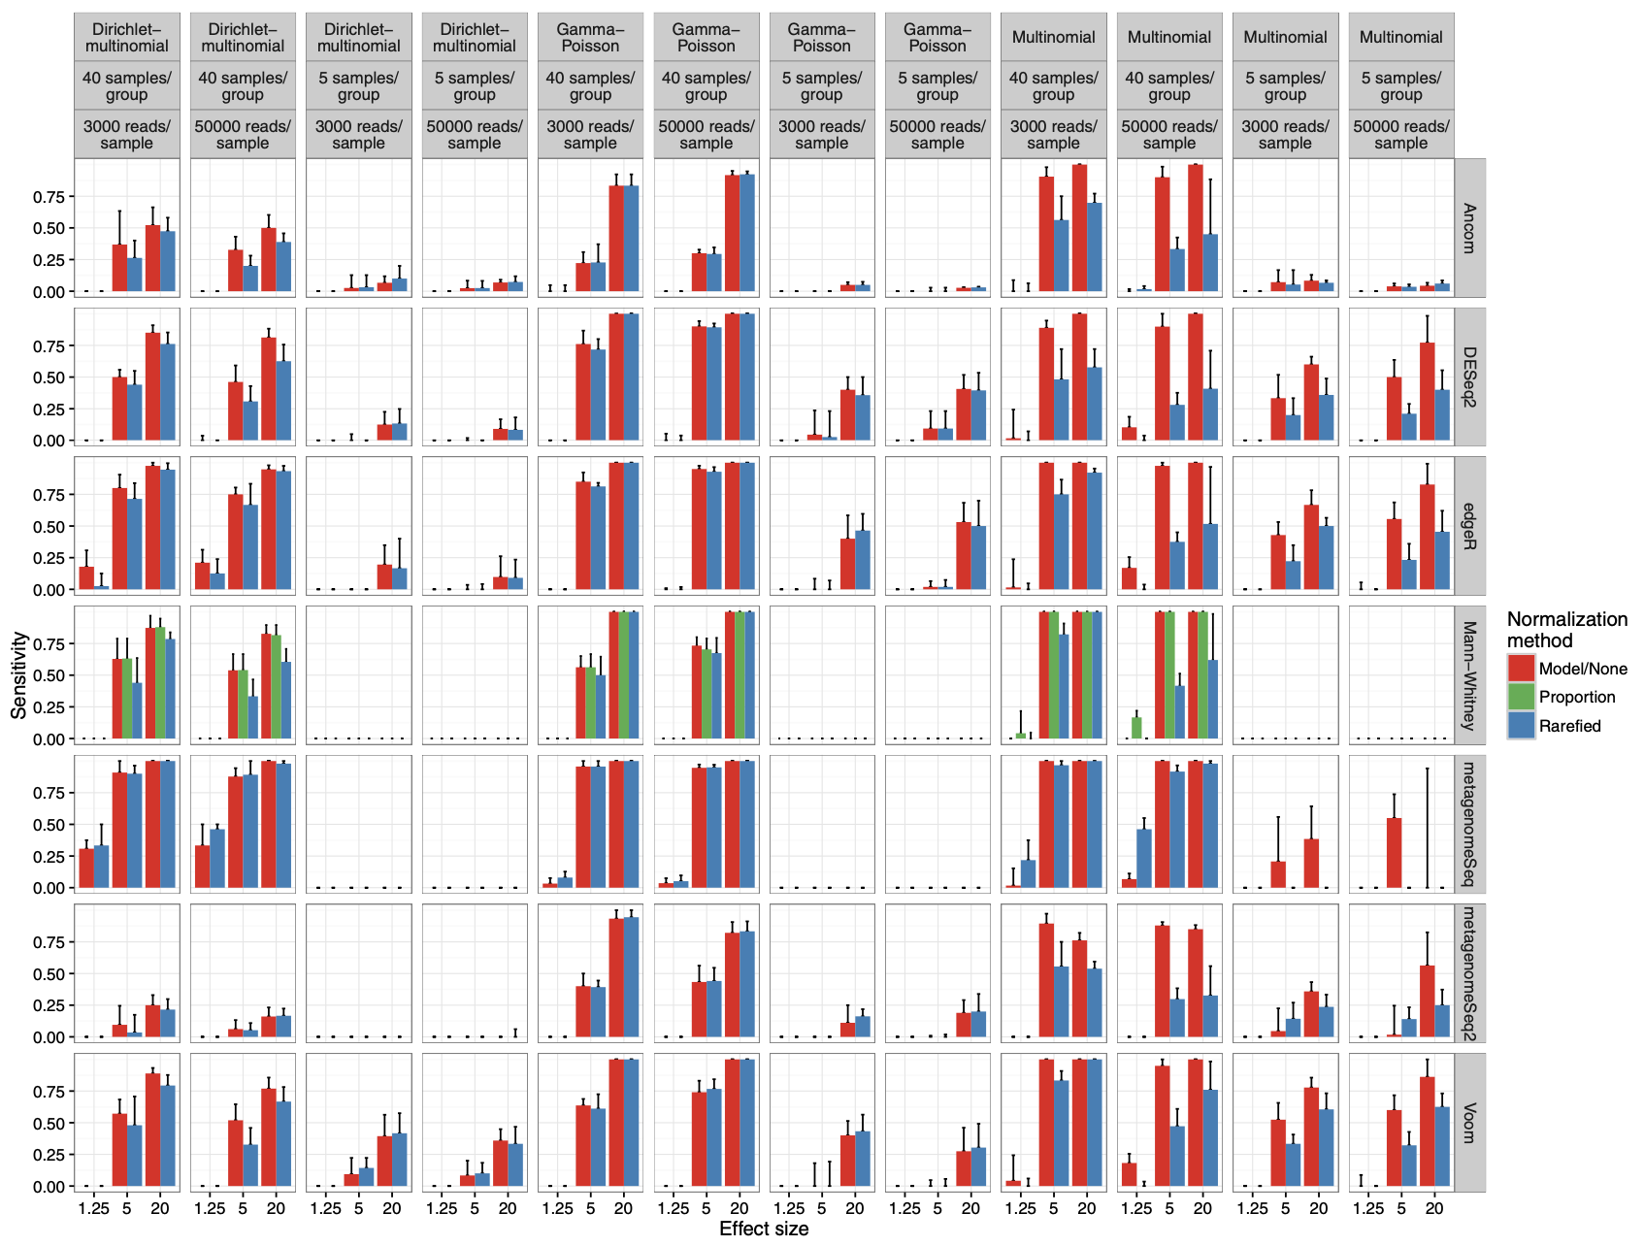
Fig. 4 Differential abundance detection sensitivity with varied library sizes, that are approximately even on average between groups.

Slide 17
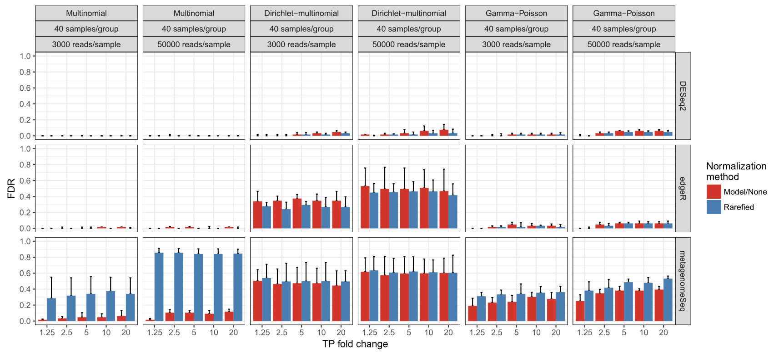
Fig. 5 Differential abundance detection false discovery rate with varied library sizes that are approximately even on average between groups.

Slide 18
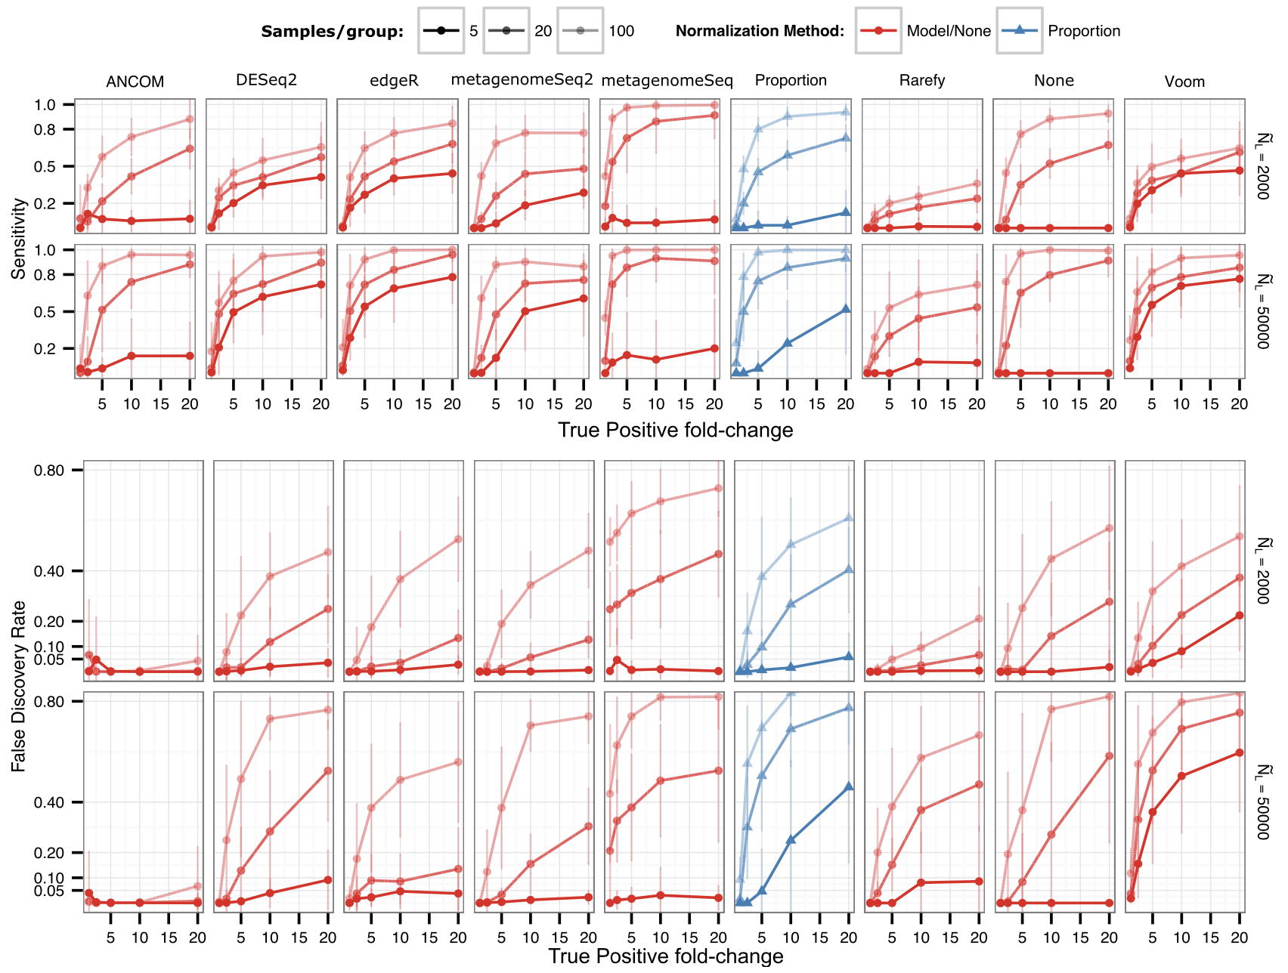
Fig. 6 Differential abundance detection performance when sample relative abundances do not reflect ecosystem relative abundances

Slide 19
Summary:
edgeR is an useful method for microbiome data differential analysis
High sensitivity and high false positive
False positive increase dramatically with large sample size
No methods is perfect. Using multiple methods in parallelmight be a choice.

Slide 20
Thanks
984,300
Questions？

