Slide 1

Mothur and QIIME2
Theory of Microbiome Analysis Workshop
Zhiwei Li
Department of Food Science and Agricultural Chemistry
McGill University
October 3, 2022

Slide 2
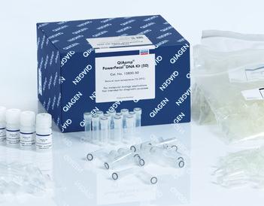
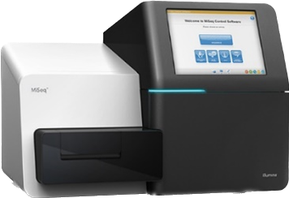
Background
Here’s where I started
Bacterial pathogens:
I’m so ready

Slide 3
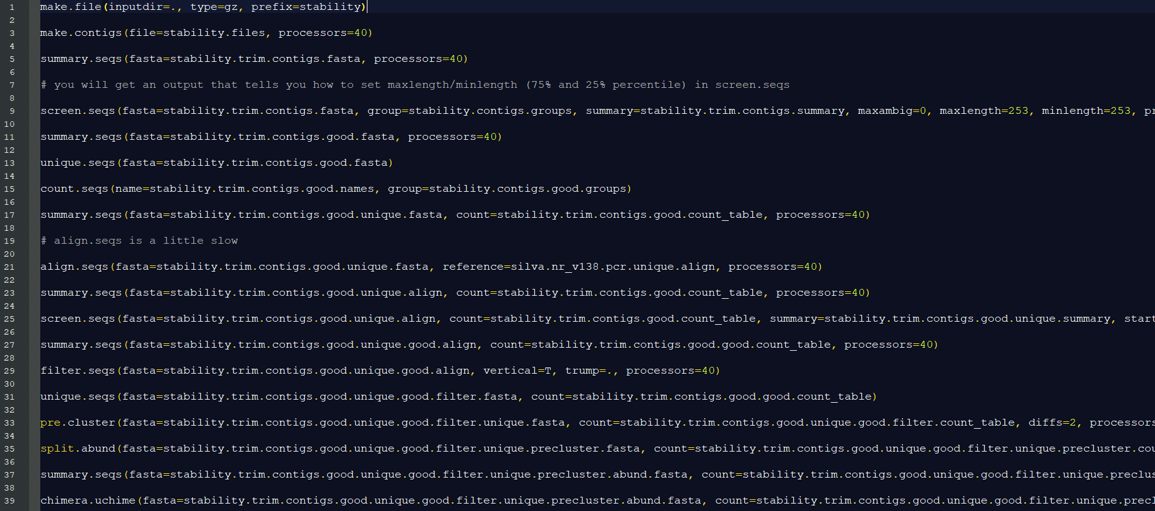
Background
Here’s where I started
P. D. Schloss et al., Introducing mothur: Open-Source, Platform-Independent, Community-Supported Software for Describing and Comparing Microbial Communities. Applied and Environmental Microbiology 75, 7537 (2009).

Slide 4
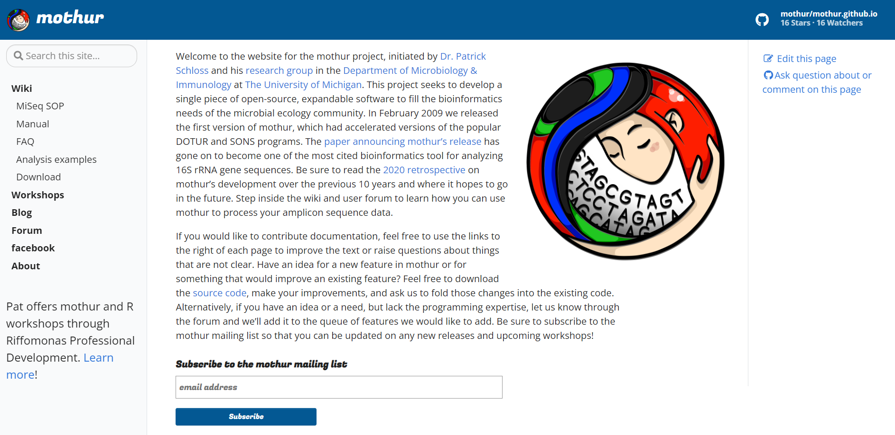
Mothur
A widely used package
https://mothur.org/

Slide 5
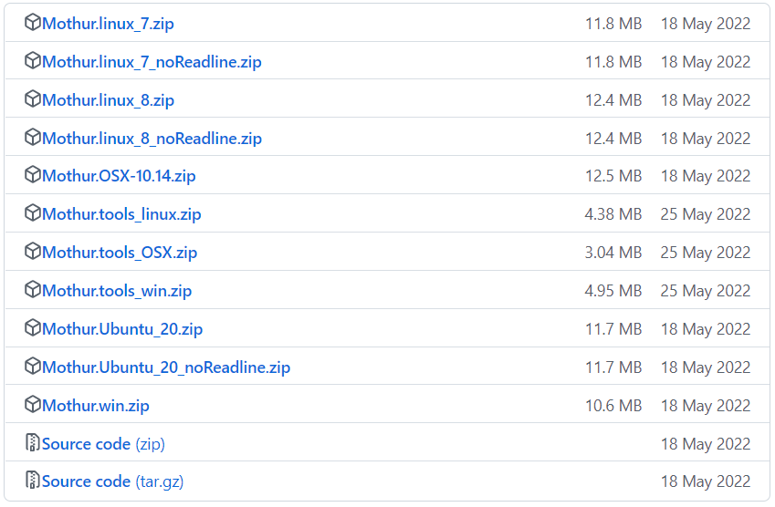
Mothur
What to prepare and expect
Mothur
Alignment reference
      Silva
      RDP
      Greengenes
      …
Inputs
Outputs
            Shared file – number of sequences per taxon per sample
            Taxonomy file – OTU/ASV
            Analysis
https://github.com/mothur/mothur/releases/tag/v1.48.0

Slide 6
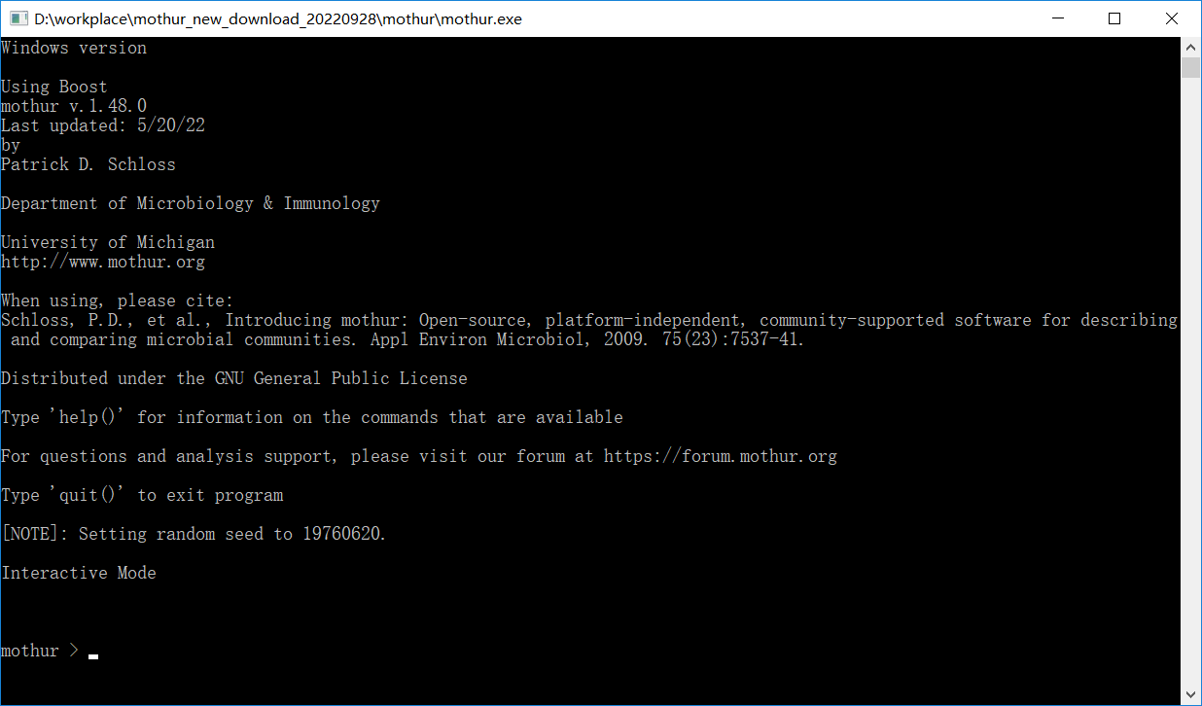
Mothur
Three modes to use Mothur
Interactive mode
Batch mode
Command line mode
P. D. Schloss et al., Introducing mothur: Open-Source, Platform-Independent, Community-Supported Software for Describing and Comparing Microbial Communities. Applied and Environmental Microbiology 75, 7537 (2009).

Slide 7
Mothur
Detailed SOPs are available
Wet-lab
  16S rRNA Sequencing with the Illumina MiSeq: Library Generation, QC, & Sequencing
    V4 region of the 16S rRNA gene
    Dual-index sequencing
    2 x 250bp paired-end fully overlapped reads
Dry-lab
  Reducing sequencing and PCR errors
  Processing improved sequences
  Preparing for analysis
  Analysis
J. J. Kozich, S. L. Westcott, N. T. Baxter, S. K. Highlander, P. D. Schloss, Development of a Dual-Index Sequencing Strategy and Curation Pipeline for Analyzing Amplicon Sequence Data on the MiSeq Illumina Sequencing Platform. Applied and Environmental Microbiology 79, 5112 (2013).

Slide 8
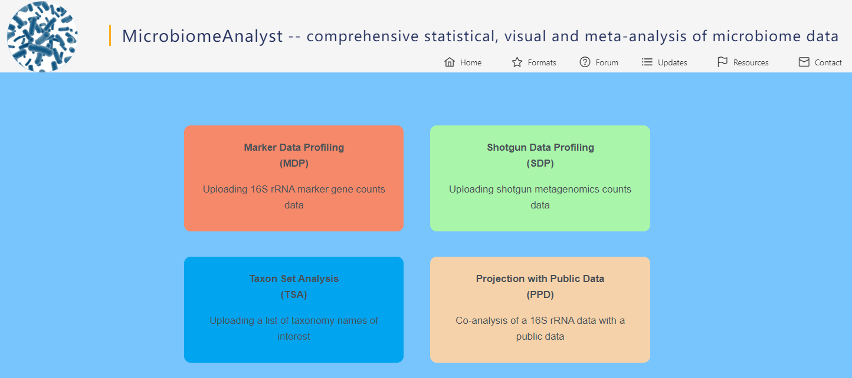
Mothur
Visualization is not included
R
MicrobiomeAnalyst
…
https://www.r-project.org/
J. Chong, P. Liu, G. Zhou, J. Xia, Using MicrobiomeAnalyst for comprehensive statistical, functional, and meta-analysis of microbiome data. Nature Protocols 15, 799-821 (2020).

Slide 9
Mothur
Mothur’s focus: quality
Mothur crashes when reading super big distance files
  Set a cut-off to reduce the size
  Problems caused by poor quality data
Mothur team suggests using fully overlapped reads
  Errors in the first read will be corrected by the second read
  An error rate below 0.02%
If you are looking at more similar communities, you need high quality data

Slide 10

Mothur is like a mom

Slide 11

But the kid grows up and wants to explore more

Slide 12
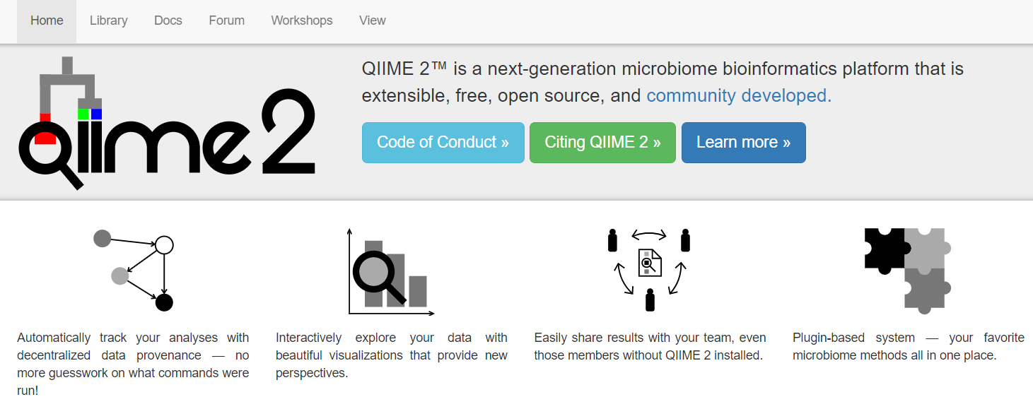
QIIME2
Another widely used package
E. Bolyen et al., Reproducible, interactive, scalable and extensible microbiome data science using QIIME 2. Nature Biotechnology 37, 852-857 (2019).

Slide 13
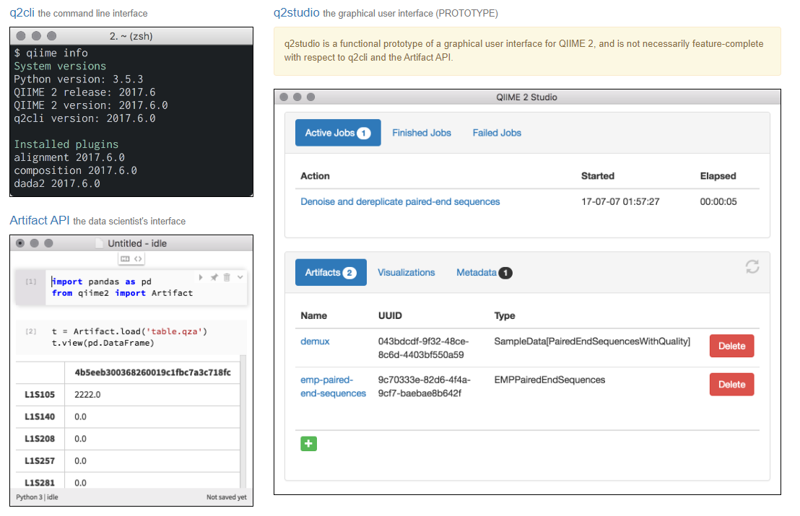
QIIME2
Different interfaces to choose
q2cli: the command line interface
Artifact API: the data scientist's interface
q2studio: the graphical user interface
https://qiime2.org/

Slide 14
QIIME2
What to prepare and expect
Installation
  Conda – environment
  Virtual Machine – Docker
  Singularity – build an image
Data files
  QIIME 2 artifacts (.qza)
  Visualizations (.qzv)
https://docs.qiime2.org/2022.8/install/

Slide 15
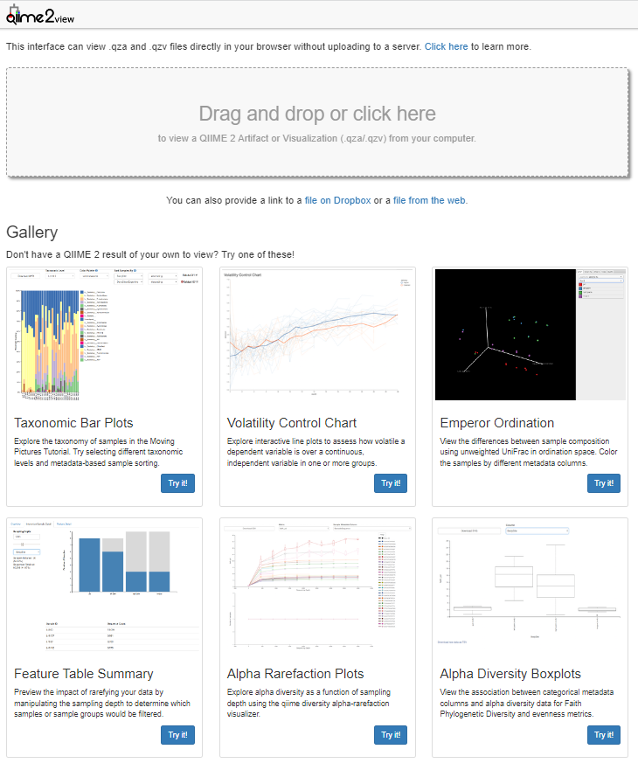
QIIME2
Visualization
https://view.qiime2.org/

Slide 16
QIIME2
Plugin
alignment: Plugin for generating and manipulating alignments.
composition: Plugin for compositional data analysis.
cutadapt: Plugin for removing adapter sequences, primers, and other unwanted sequence from sequence data.
dada2: Plugin for sequence quality control with DADA2.
deblur: Plugin for sequence quality control with Deblur.
demux: Plugin for demultiplexing & viewing sequence quality.
diversity: Plugin for exploring community diversity.
diversity-lib: Plugin for computing community diversity.
emperor: Plugin for ordination plotting with Emperor.
feature-classifier: Plugin for taxonomic classification.
feature-table: Plugin for working with sample by feature tables.
fragment-insertion: Plugin for extending phylogenies.
gneiss: Plugin for building compositional models.
longitudinal: Plugin for paired sample and time series analyses.
metadata: Plugin for working with Metadata.
phylogeny: Plugin for generating and manipulating phylogenies.
quality-control: Plugin for quality control of feature and sequence data.
quality-filter: Plugin for PHRED-based filtering and trimming.
sample-classifier: Plugin for machine learning prediction of sample metadata.
taxa: Plugin for working with feature taxonomy annotations.
types: Plugin defining types for microbiome analysis.
vsearch: Plugin for clustering and dereplicating with vsearch.
…
https://docs.qiime2.org/2022.8/plugins/

Slide 17
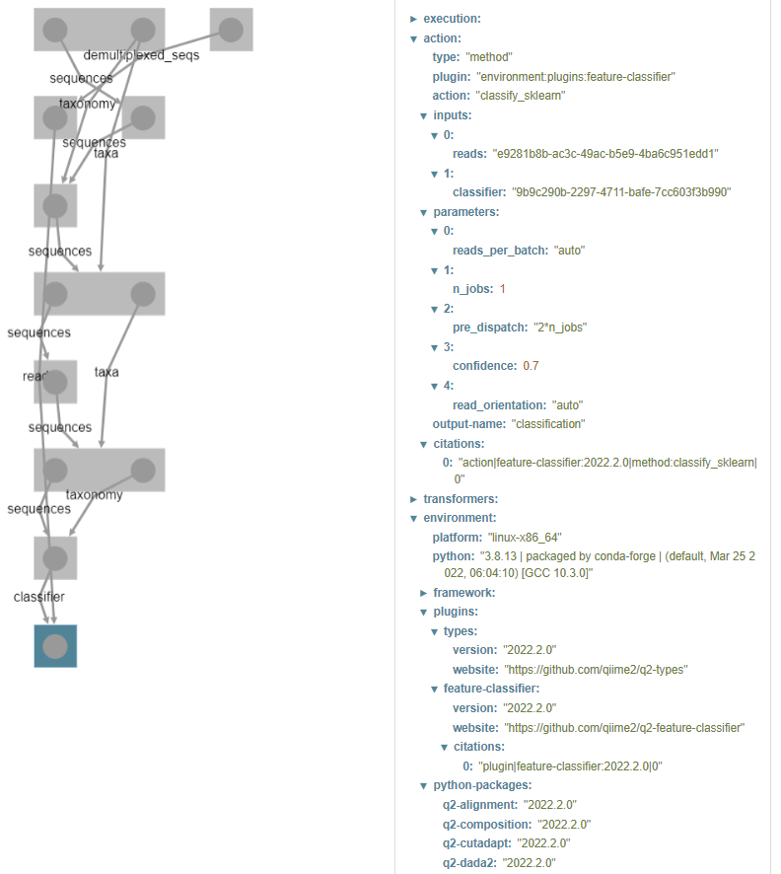
QIIME2
Tracking of data provenance
Action
Inputs
Parameters
Plugins
Packages
Version
…

Slide 18
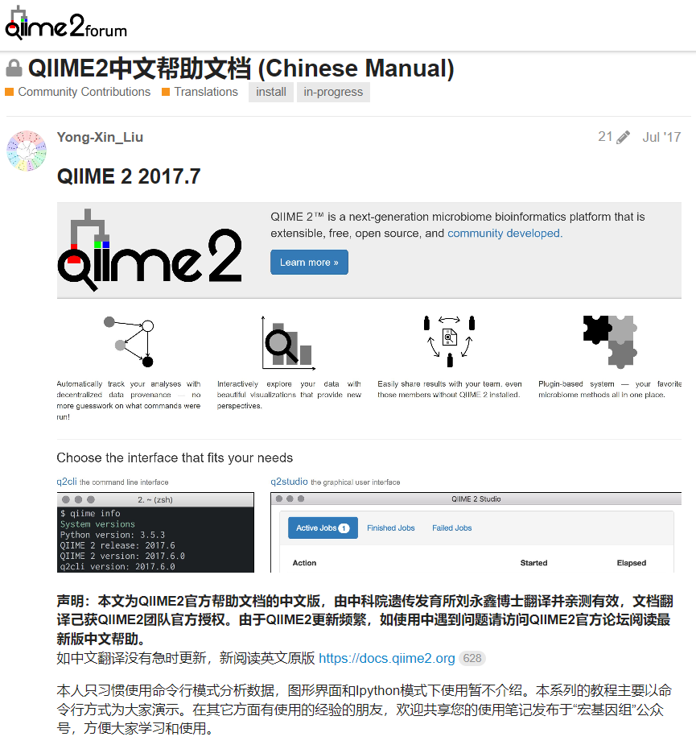
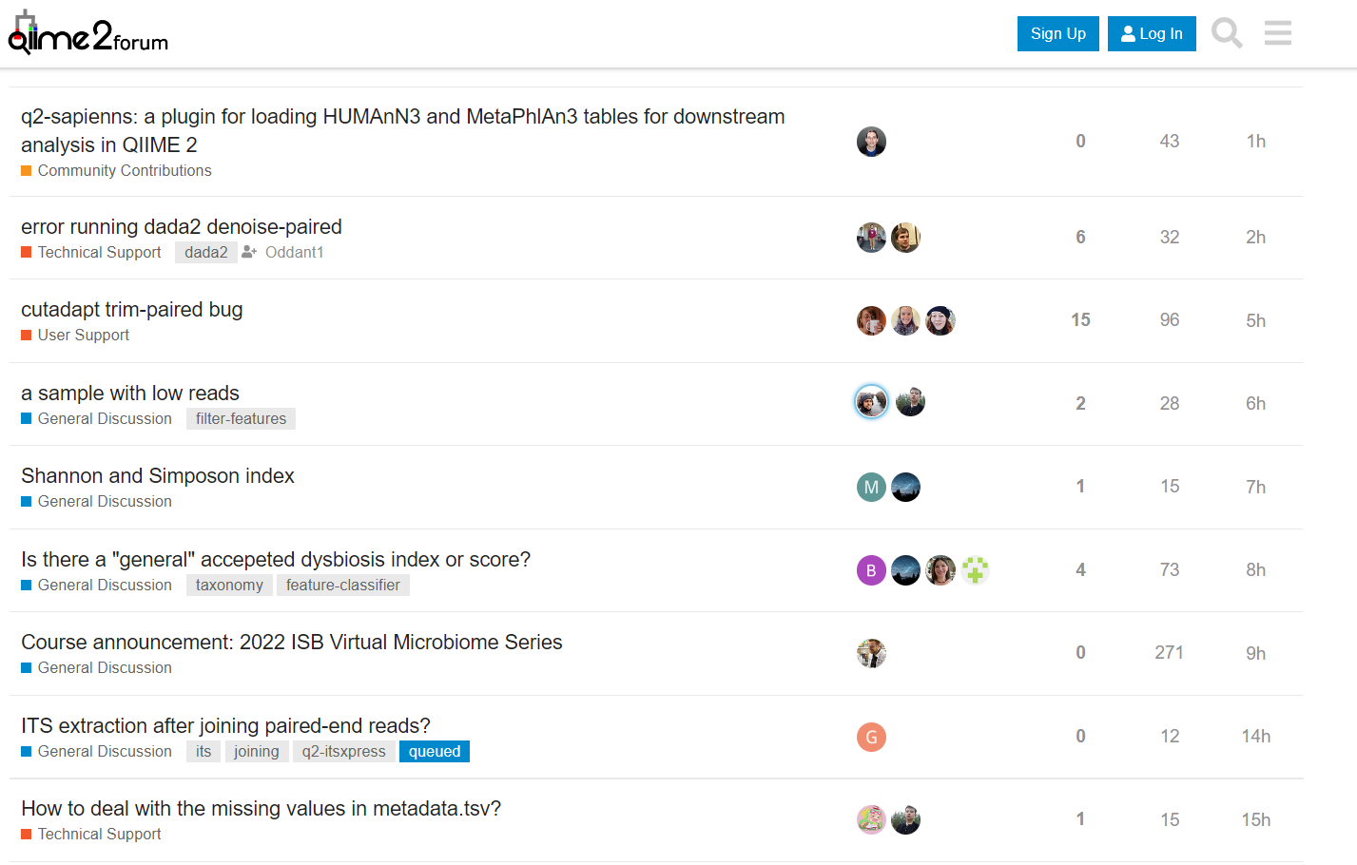
QIIME2
Community developed
https://forum.qiime2.org/
https://forum.qiime2.org/t/qiime2-chinese-manual/838

Slide 19
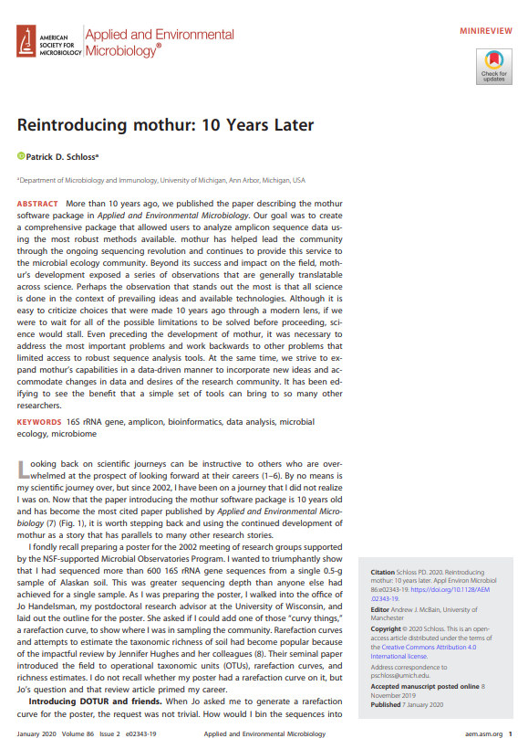
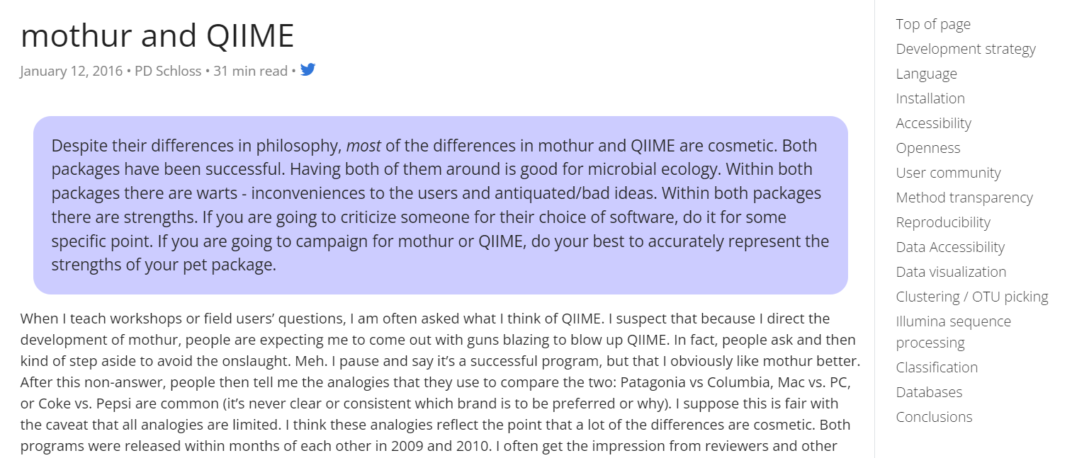
In the end
Which one is better?
P. D. Schloss, Reintroducing mothur: 10 Years Later. Applied and Environmental Microbiology 86, e02343-02319 (2020).
https://mothur.org/blog/2016/mothur-and-qiime/

Slide 20

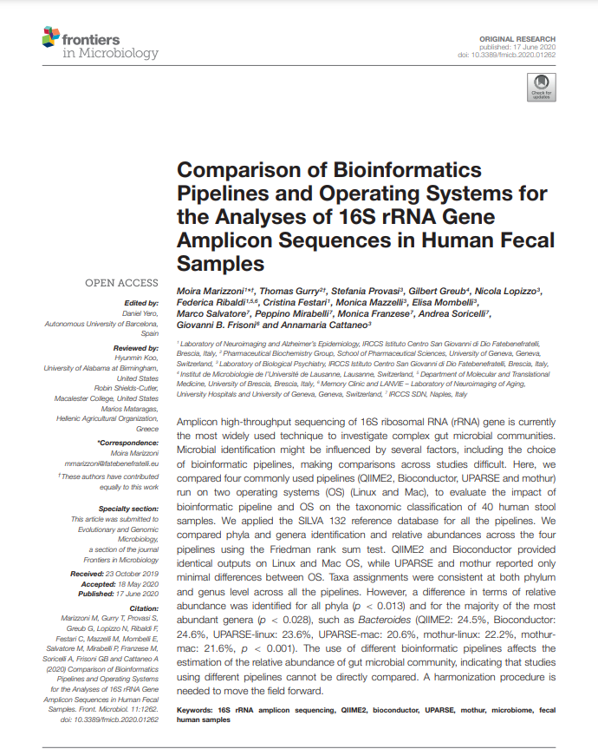
In the end
Which one is better?
López-García et al., Comparison of Mothur and QIIME for the Analysis of Rumen Microbiota Composition Based on 16S rRNA Amplicon Sequences. Frontiers in Microbiology 9 (2018).
M. Marizzoni et al., Comparison of Bioinformatics Pipelines and Operating Systems for the Analyses of 16S rRNA Gene Amplicon Sequences in Human Fecal Samples. Frontiers in Microbiology 11 (2020).

Slide 21
In the end
Which one to choose?
The one that your supervisor/most of your lab mates use
Mothur is like a mom
    Its pipeline helps us to go through all the steps from the beginning to the end, and ensures our sequencing results are in good quality before it starts processing
QIIME2 is like our friend
    It provides us with infinite possibilities to analyze our data in our way, but we really need to know what we are doing, otherwise the outputs might just be errors.

Slide 22
In the end
They are equally good
Mothur
HIGH QUALITY
A high performance program
Consistency alongside the whole pipeline
High quality assurance
QIIME2
INFINITE POSSIBILITIES
Connects a large number of packages
Data provenance
Visualization

Slide 23
Thank you!
I like Mothur,
I also like QIIME2

