Slide 1
DADA2 (Divisive Amplicon Denoising Algorithm 2)
Esteban Góngora
PhD Candidate in Microbiology
Department of Natural Resource Sciences, McGill University
Theory of Microbiome Analysis Workshop
October 3, 2022

Slide 2
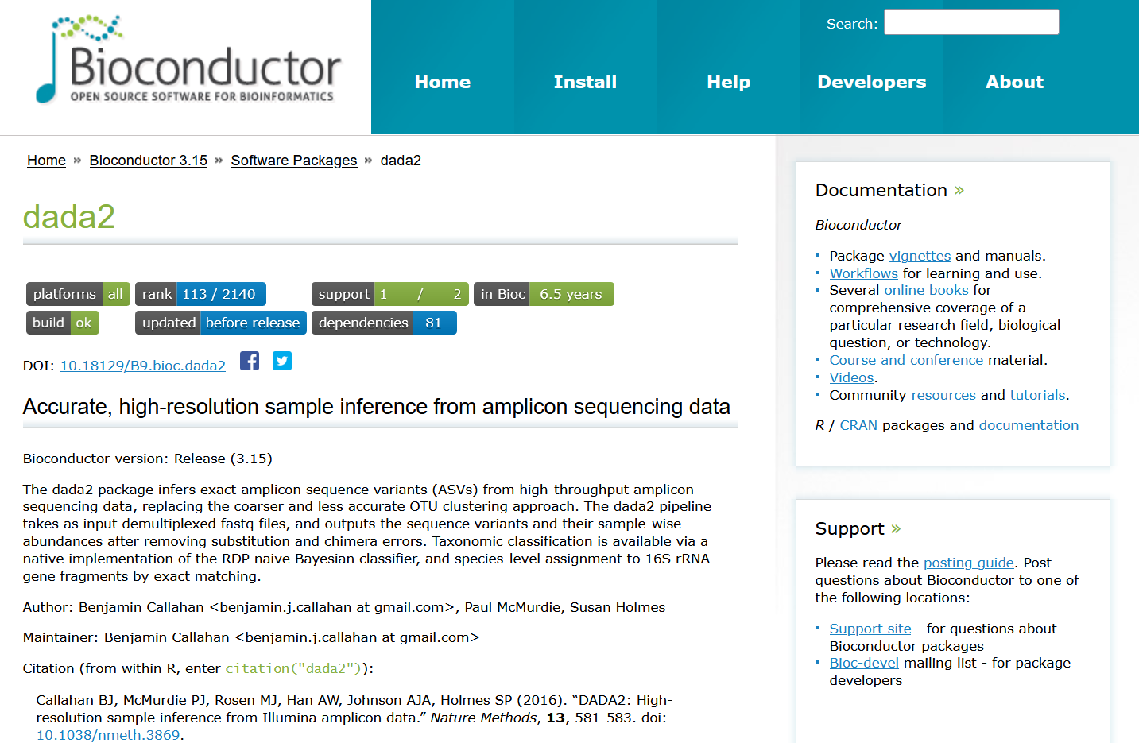

Slide 3

How does DADA2 work?
1. Filtering
2. Learn errors
3. Dereplication
4. Denoising
5. Paired end merging
6. Chimera removal
7. Assign taxonomy

Slide 4
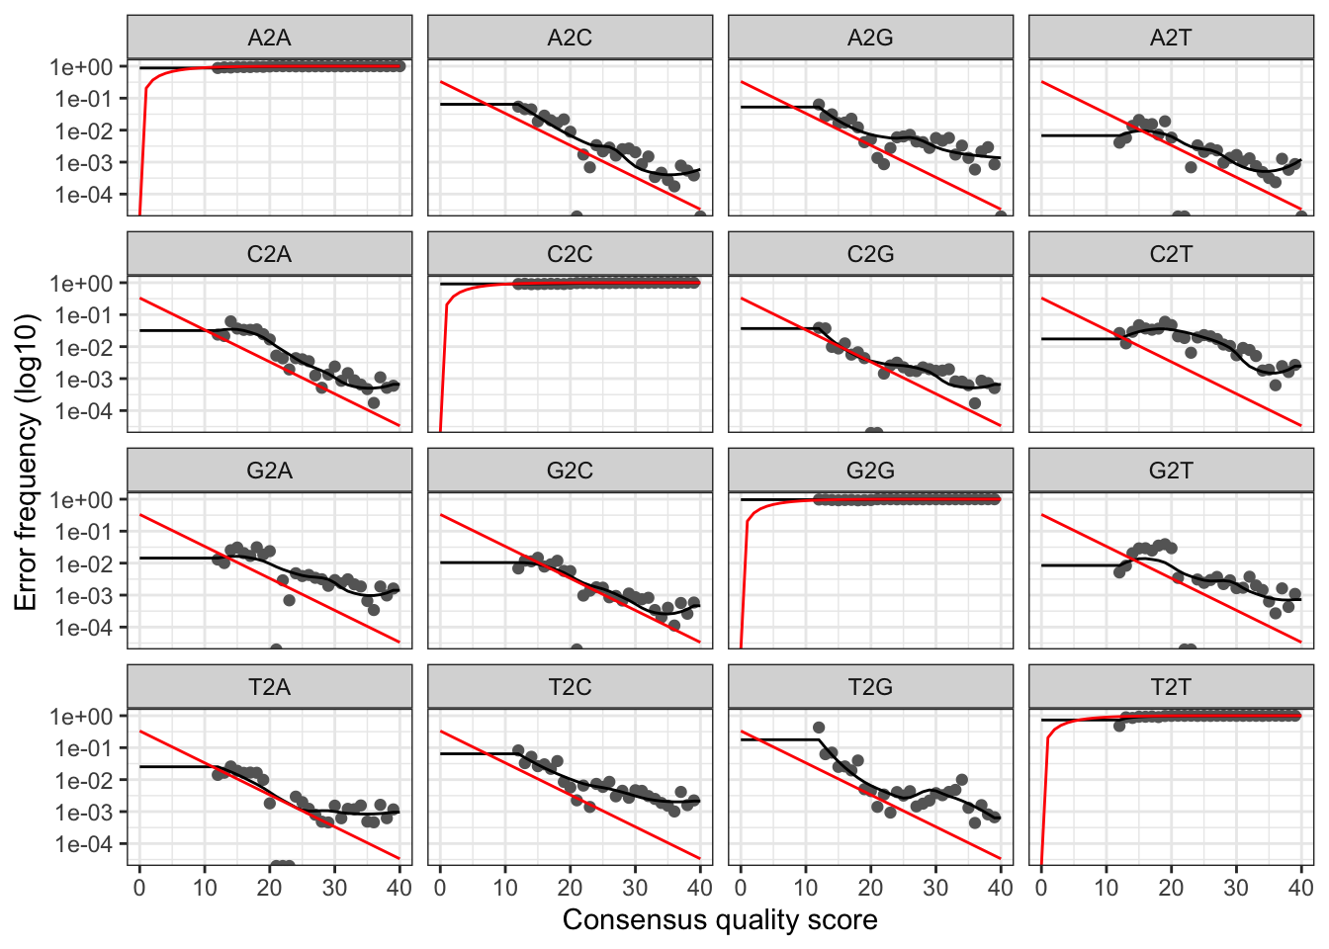
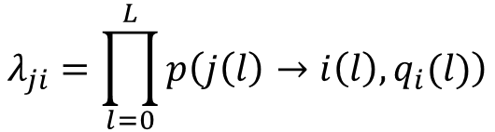
2. Learn errors
$$λ_{ji}=\prod_{l=0}^{L}{p\left(j\left(l\right)→i\left(l\right),q_{i}(l)\right)}$$
Inferred error model
Expected error rate based on quality score (Q) definition

Slide 5

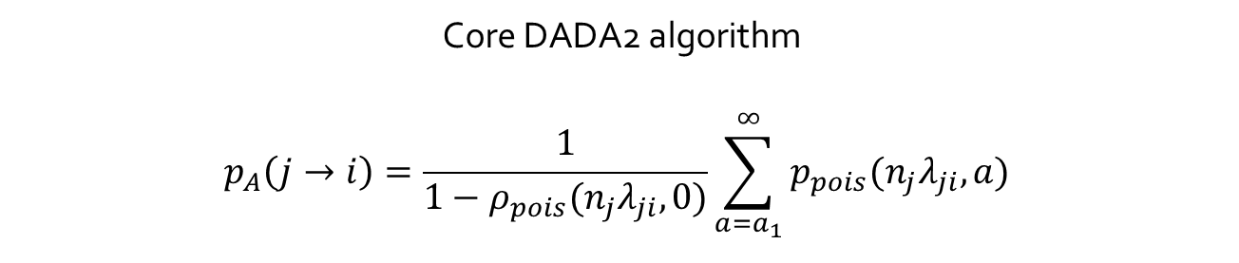
4. Denoising
Core DADA2 algorithm
$$p_{A}\left(j→i\right)=\frac{1}{1−ρ_{pois}(n_{j}λ_{ji},0)}\sum_{a=a_{1}}^{∞}{p_{pois}(n_{j}λ_{ji},a)}$$
10
10
10
10
 | A | C | T | G
A | 0.97 | 10⁻² | 10⁻² | 10⁻²
C | 10⁻² | 0.97 | 10⁻² | 10⁻²
T | 10⁻² | 10⁻² | 0.97 | 10⁻²
G | 10⁻² | 10⁻² | 10⁻² | 0.97
 | A | C | T | G
A | 0.997 | 10⁻³ | 10⁻³ | 10⁻³
C | 10⁻³ | 0.997 | 10⁻³ | 10⁻³
T | 10⁻³ | 10⁻³ | 0.997 | 10⁻³
G | 10⁻³ | 10⁻³ | 10⁻³ | 0.997
 | A | C | T | G
A | 0.998 | 1×10⁻⁴ | 2×10⁻³ | 2×10⁻⁴
C | 6×10⁻⁵ | 0.998 | 3×10⁻⁶ | 1×10⁻³
T | 1×10⁻³ | 3×10⁻⁶ | 0.998 | 6×10⁻⁵
G | 2×10⁻⁴ | 2×10⁻³ | 1×10⁻⁴ | 0.998
50
50
50
50
$$λ_{ji}=$$
100
100
100
100
We continue this process until all real sequences converge under OMEGA_A and only errors that are plausible are left
If any of the “error” sequences has a Bonferroni corrected p_{A} lower than the OMEGA_A parameter (1 × 10⁻⁴⁰ by default), a new real sequence is recruited
So we recruit the “error” with the lowest p_{A} as a real sequence and recalculate the model again
We first assume that there is a single real sequence and many errors
And then we estimate the error model under this assumption to calculate the p_{A} for every sequence

Slide 6
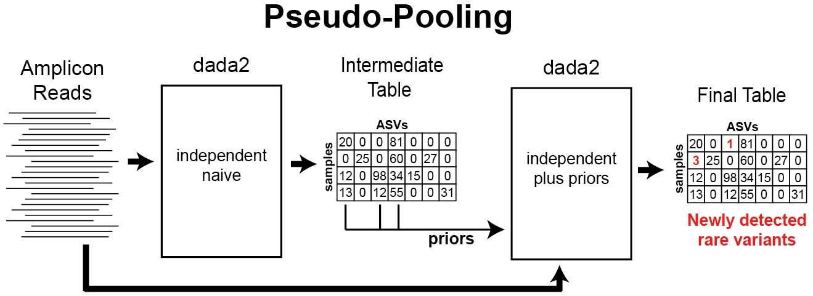
Pooling and pseudo-pooling
→ All singletons have a p_{A} of 1 (always consistent with the error model)
→ For pooling, information is shared across samples
→ But it takes much more time and computer resources
→ Pseudo-pooling is an alternative that presents a compromise between processing time and sensitivity to rare variants

Slide 7
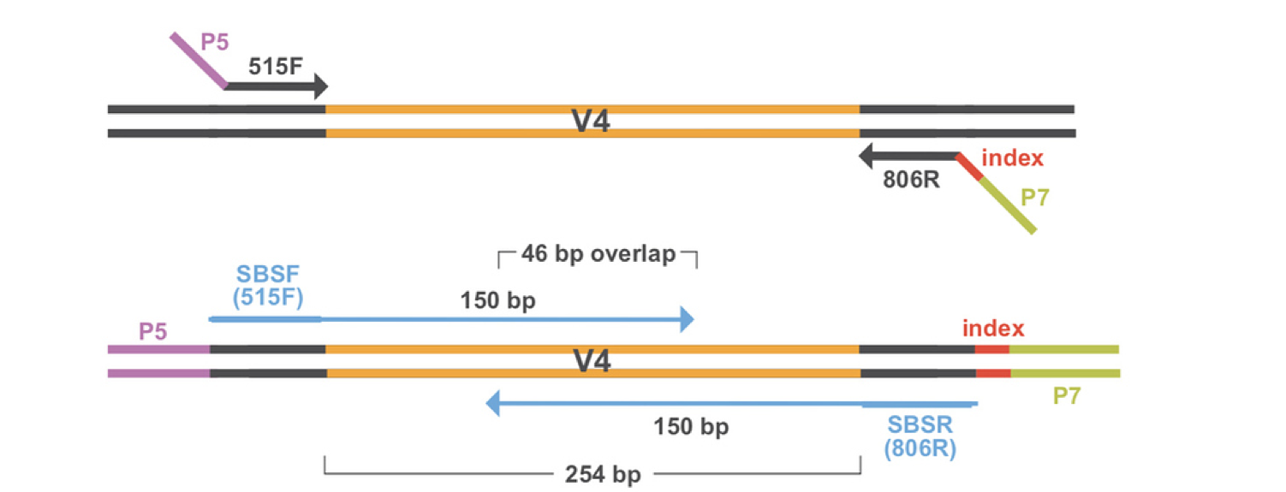
5. Paired end merging
→ Performed after denoising
→ Can merge sequences that overlap by as little as 12 bases (default)!
Source: Data Carpentry
Notes:
https://elizabethmcd.github.io/R-amplicons/img/paired_end.png

Slide 8
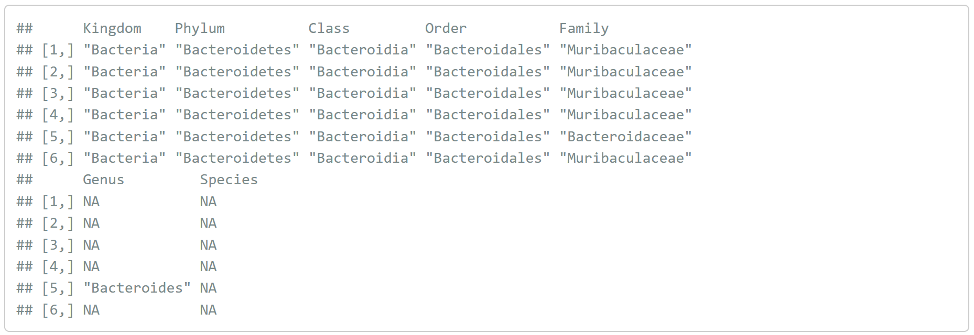
7. Assign taxonomy
→Training sets are available for the RDP, Greengenes, and Silva databases
→ Can perform exact classification up to species (optional)

Slide 9
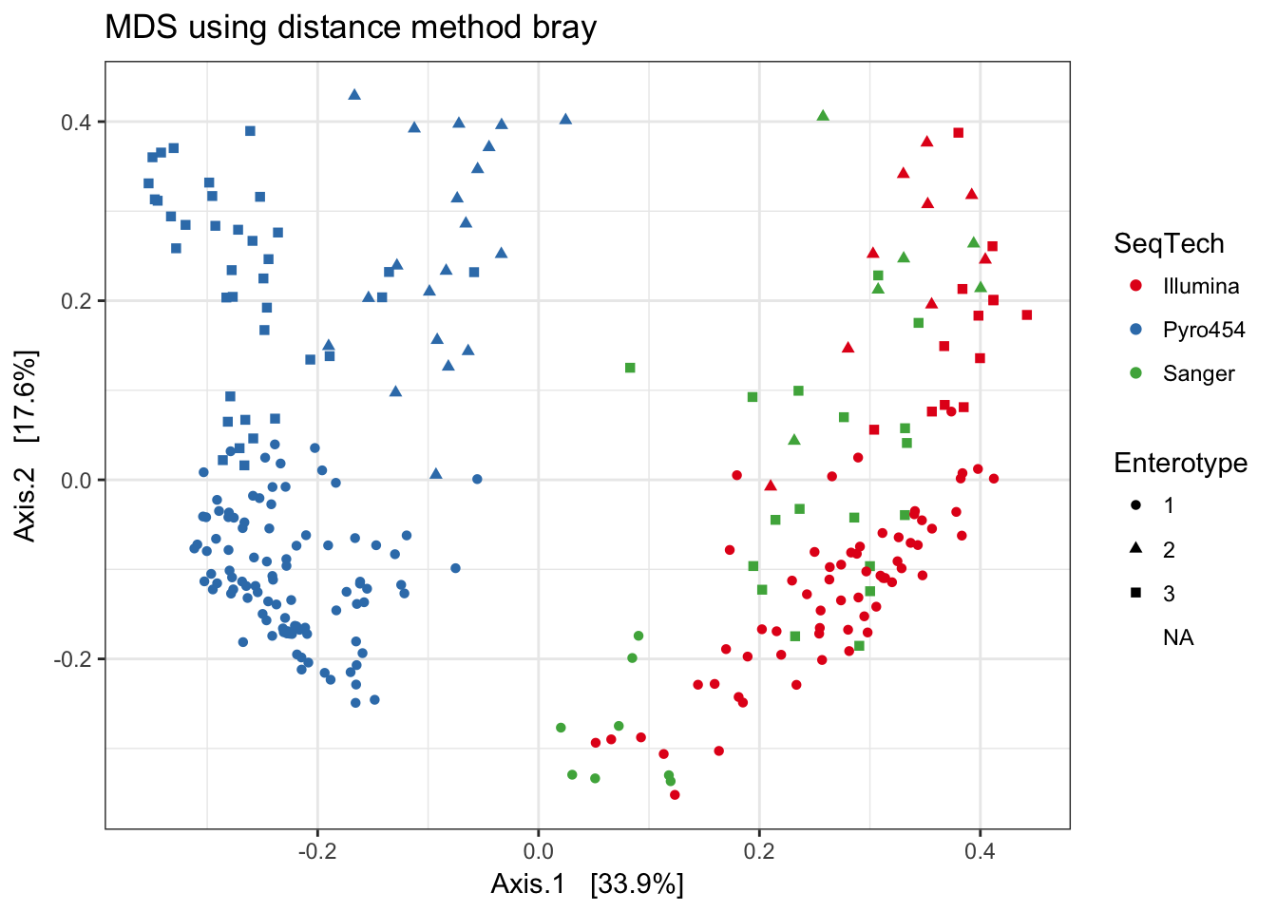
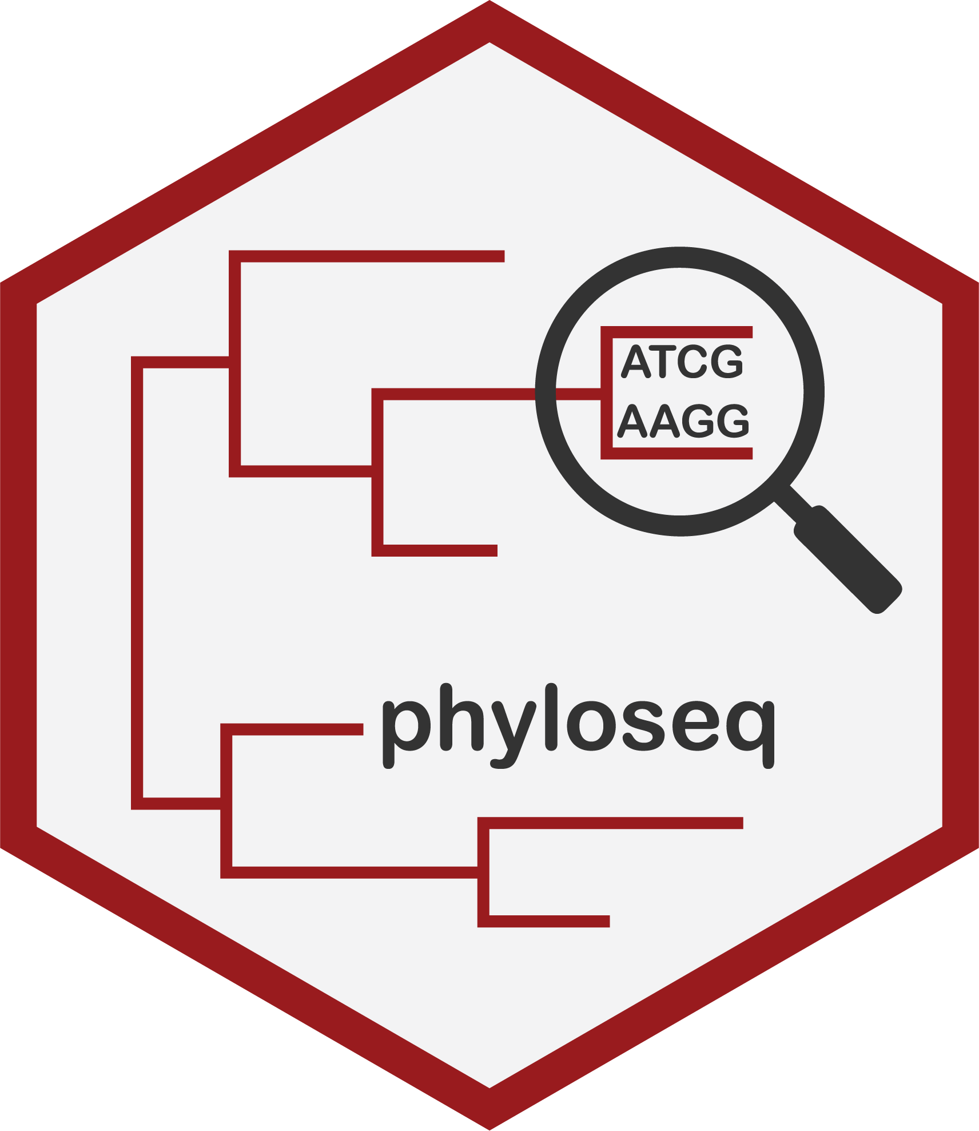
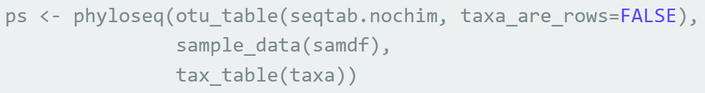
We got ASVs!
Now what?
DADA2 runs in R
DADA2 results are easily integrated to phyloseq!
phyloseq is also integrated with DESeq2 to perform differential abundance analysis

Slide 10
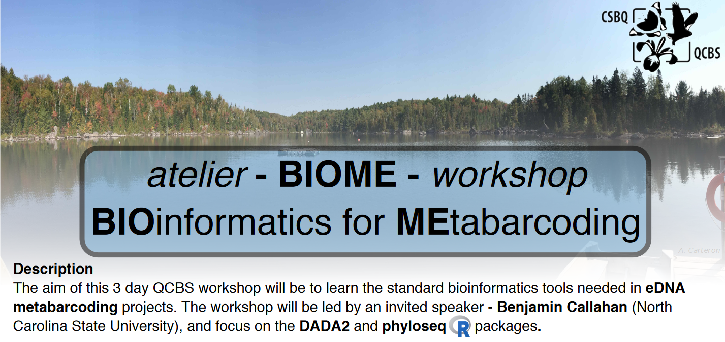

Acknowledgement

