Slide 1
Theory of Microbiome Analysis Workshop
16S rRNA Sequencing and Analysis: Data Tranformation
Yao Lu
PhD Candidate
Department of Microbiology and Immunology
Micgill University
2022-Oct-03

Slide 2
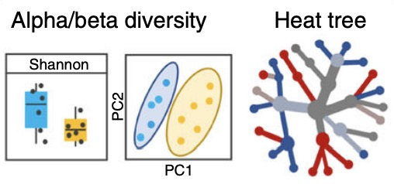
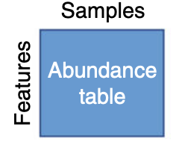
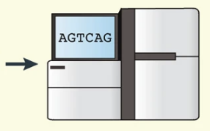

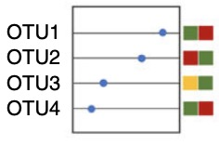
Workflow of 16S rRNA sequencing data analysis
Comunity profiling
Data processing
Filtration
Normalization
Pre-processing
Differential analysis
Mothur
QiiME2
DADA2
LEfSe
Wilcoxon
DESeq2
edgeR
......

Slide 3
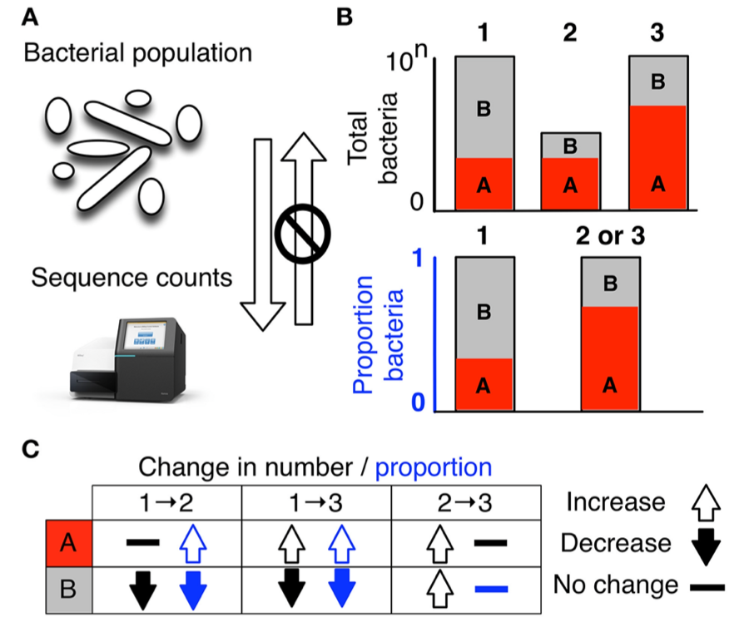
Why normalization?
Uneven sampling depth (library size)
Sparsity (zero values)
Compositional
Gloor, Gregory B., et al. Frontiers in microbiology 8 (2017): 2224.

Slide 4
Normalization Methods

Slide 5
Normalization:
transforming the data in order to enable accurate comparison of statistics from different measurements
Rarefaction | Refary to minimum library size
Scaling | Total sum scaling (TSS) Cumulative sum scaling (CSS) Upper-quartile normalization (UQ)
Transformation | Trimmed mean of M-values (TMM) Variance stabilizing transformation(VST) Relative log expression (RLE) Centered log ratio (CLR) Analysis of Compositions of Microbiome with Bias Correction (ANCOM-BC) Wrench Geometric mean of pairwise ratios (GMPR)

Slide 6
Scaling:
multiply feature counts by a sample-specific factor to account for uneven sequencing depth, transforming raw reads into relative abundances.
Method | Scaling factor | Correction | Count type after normalization | Application and limits
TSS | Total number of sample reads | Total reads | Relative | recommend for beta diversity analysis failure to account for heteroscedasticity dominated by few highly abundant features
CSS | Cumulative sum of counts (up to threshold q) | Sequencing depth | Relative | recommend for controlling the FDR in data with large group sizes when performing differential abundance analysis determination of the thresholds could fail due to high count variability
UQ | Upper quartile counts | Sequencing depth | Relative

Slide 7
Transformation I:
stabilize the variance of the data
Method | Scaling factor | Correction | Count type after normalization | Application and limits
VST | Median ratio of gene counts relative to geometric mean per gene | Sequencing depth, compositionality | Absolute | less influenced by a few preferentially sampled feature assume most features are not differential abundant, and there is an approximately balanced amount of increased/decreased abundance pseudocount required CLR and VST generates negative values
TMM | Trimmed mean of logged expression ratios/ Inverse Variance | Sequencing depth, compositionality | Absolute
CLR | Log ratio of observed values and their geometric means | Compositionality | Relative
RLE | Ratio between gene abundances and their geometric mean | Sequencing depth, compositionality | Relative

Slide 8
Transformation II:
designed for microbiome data; address the compositionality and sparsity;
Method | Scaling factor | Correction | Count type after normalization | Application and limits
ANCOM-BC | Ratio of expected absolute abundance to ratio of library size to microbial load | Sequencing depth, compositionality | Absolute | eliminate the differential sampling fractions between each group and allow inference of absolute abundance from relative abundance failure when the sample sizes are very small
Wrench | Group-wise and sample-wise compositional bias factor | Sequencing depth, compositionality, sparsity | Absolute | remove sequencing machine-induced biases inability to normalize based on continuous covariates
GMPR | Geometric mean of the pairwise ratio of nonzero counts | Sequencing depth, compositionality, sparsity | Relative | yields better FDR and higher power in the context of differential abundance testing failure for distanced based statistical methods such as the permutational multivariate differential testing PERMANOVA, clustering, or ordination

Slide 9
Results from reviews

Slide 10
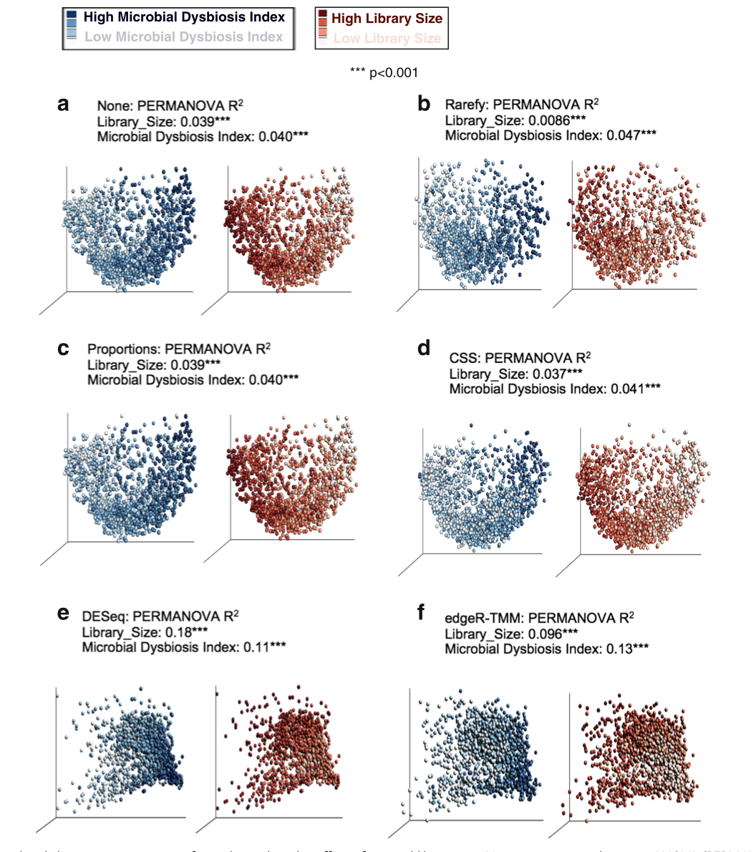
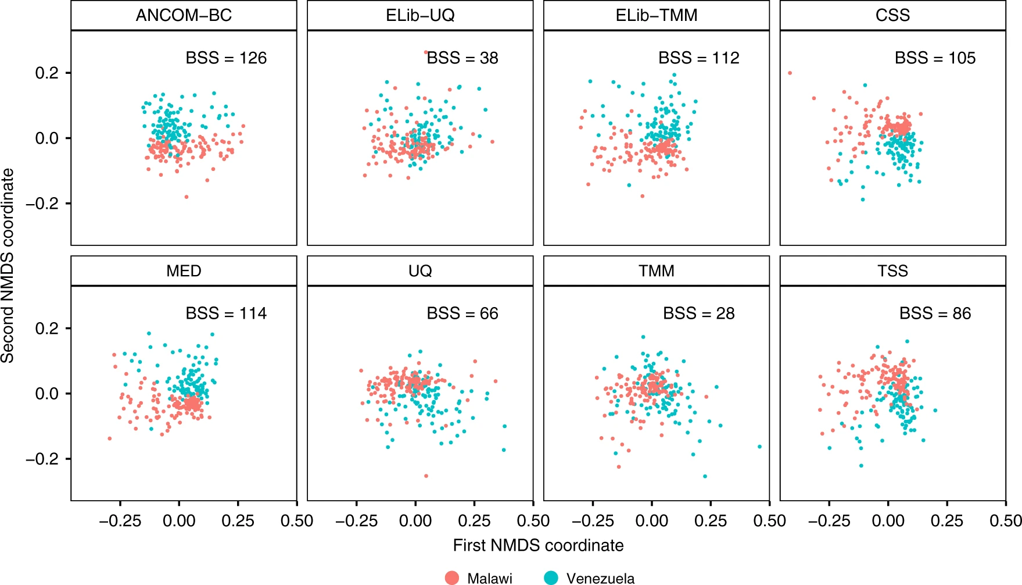
Overall performance I
Elib-TMM: enhanced TMM edgeR package
Weiss et al. Microbiome (2017) 5:27
Huang L. et al. Nature Communications (2020)11:3514

Slide 11
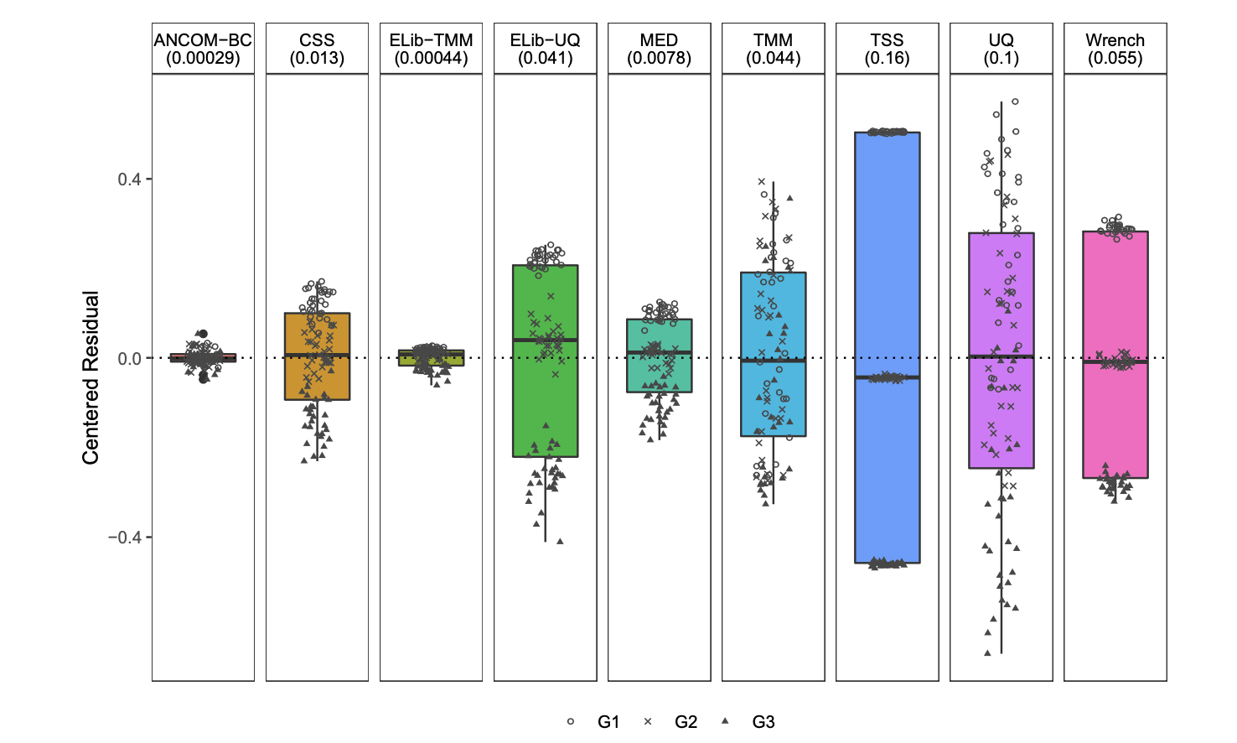
Overall performance II:
Box plot of residuals between true sampling fraction and its estimate for each sample.
Huang L., et al. npj Biofilms and Microbiomes (2020) 6:60

Slide 12
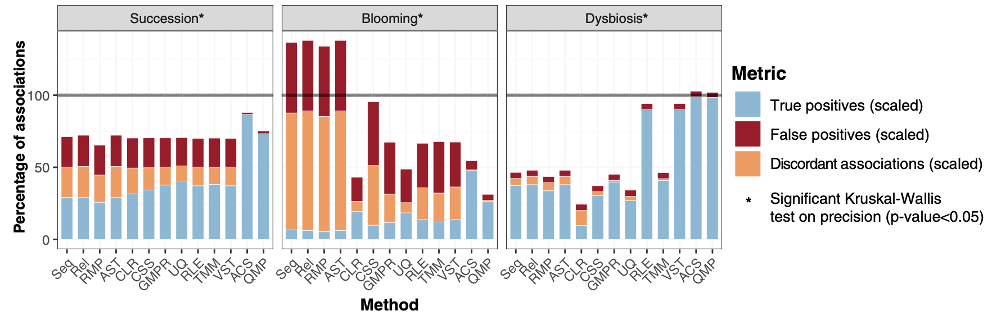
Overall performance III
Performance of transformation methods in recovering taxon-load associations
Verónica Lloréns-Rico., et al. Nature Communications (2021)12:3562

Slide 13
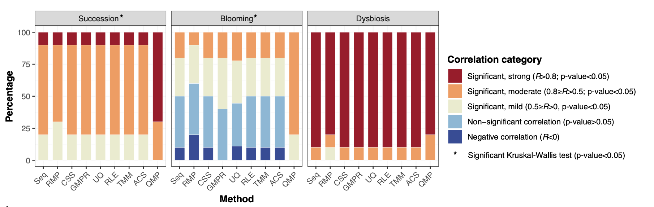
Effect on alpha-diversity:
Correlation between the observed richness in the original synthetic communities and (transformed) sequence matrices
Verónica Lloréns-Rico., et al. Nature Communications (2021)12:3562

Slide 14
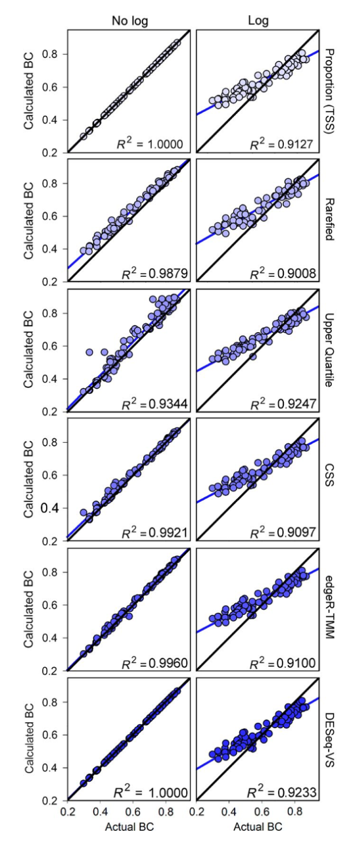
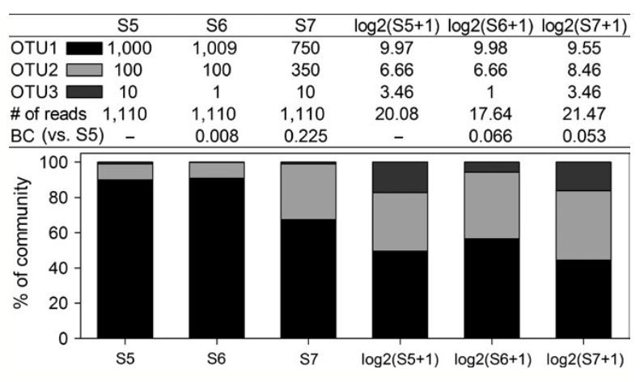
Effect on community-level comparisons:
Samples (S5–S7) from three hypothetical communities illustrating the potential problems that arise from log transforming community data
Correlations between the Bray–Curtis dissimilarities for the original (non-normalized [true]) data and the Bray–Curtis dissimilarities following normalization
Donald T. McKnight., et al. Methods Ecol Evol. 2019;10:389–400

Slide 15
Notes

Slide 16
Take home message：
ANCOM-BC, TMM and CSS have relative better performance
Library size is a frequent confounding factor that obscures biologically meaningful results
Log-like transformation does not work well with ecologically useful metrics, while TSS is suitable for community-level comparisons
Alpha-diversity does not significantly depend on the normalization method
Many microbial environments are highly variable in microbial composition, which would violate the assumption of a constant abundance of a majority of species
Normalization method selection is highly related to the downstream analysis approaches and experiment design

Slide 17
Implementation of the methods
Method | Original R package
TSS | -
CSS | metagenomeSeq
UQ | edgeR
VST | DESeq
TMM | edgeR
CLR | -
RLE | DESeq
ANCOM-BC | ANCOM-BC
Wrench | Wrench
GMPR | GMPR
Other platforms: MicrobiomeAnalyst website and R package
phyloseq R package

Slide 18
Thanks
984,300
Questions？

